Slide 1
Module 5: Feature Engineering, Production and Deployment of ML Models
Miscellaneous Topics
Ainesh Avinash Godse
24XV1M0515

Slide 2
Source: https://www.appliedaicourse.com/course/11/Applied-Machine-learning-course

Slide 3
Sources:
All information displayed here is sourced from the videos attached in the modules.
Any missing external contexts from the video have been added using Wikipedia.
The text has been formatted using LLMs to remove any spelling, grammatical or semantical mistakes.

Slide 4
Calibration of Models
What is Calibration?
Why is Calibration needed?
How does calibration work?

Slide 5
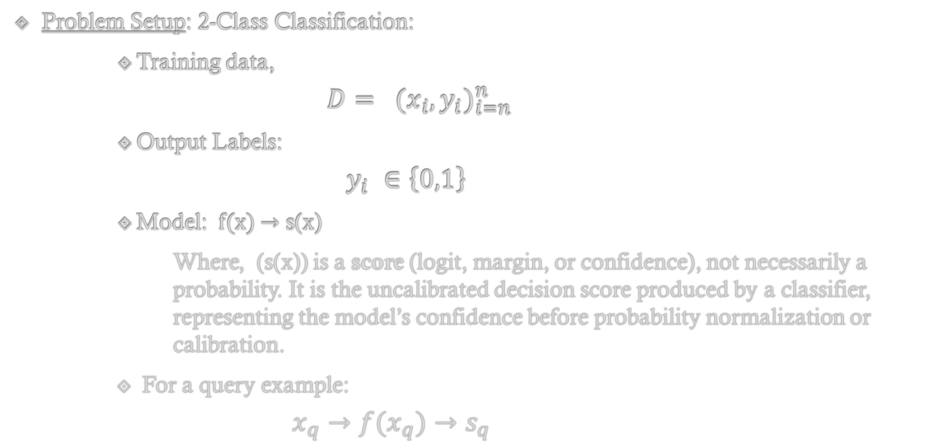
Why do we need Calibration?
Problem Setup: 2-Class Classification:
Training data,
$$D= {(x_{i},y_{i})}_{i=n}^{n}$$
Output Labels:
$$y_{i} ∈\left\{0,1\right\}$$
Model: f(x) → s(x)
Where, (s(x)) is a score (logit, margin, or confidence), not necessarily a probability. It is the uncalibrated decision score produced by a classifier, representing the model’s confidence before probability normalization or calibration.
For a query example:
$$x_{q}→f(x_{q})→s_{q}$$
Notes:
A logit is the logarithm of the odds of an event, defined as $\log\left(\frac{p}{1−p}\right)$, and is the natural output space of logistic regression.
It converts a data space from (−∞,+∞) to (0,1) space. Where 0 in (−∞,+∞) is 0.5 in (0,1) space.

Slide 6
What Is Actually Required
For decision-making and evaluation, we need posterior probabilities:
P(y_{q} = 1 | x_{q}), P(y_{q} = 0 | x_{q})
with the constraint:
P(y_{q}=1 | x_{q}) + P(y_{q}=0 | x_{q}) = 1

Slide 7
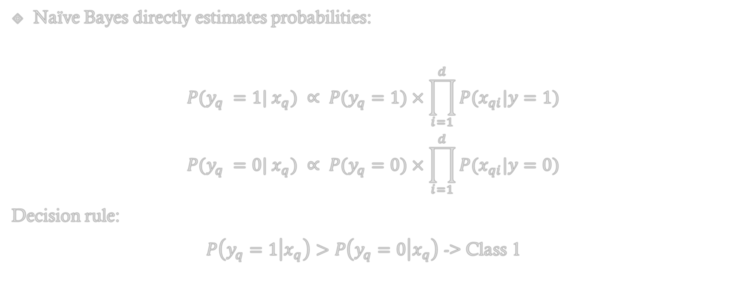
Probabilistic Models (Naïve Bayes)
Naïve Bayes directly estimates probabilities:
$$P(y_{q} =1| x_{q}) ∝ P(y_{q}=1)×\prod_{i=1}^{d}{P(x_{qi}|y=1)}$$
$$P(y_{q} =0| x_{q}) ∝ P(y_{q}=0)×\prod_{i=1}^{d}{P(x_{qi}|y=0)}$$
Decision rule:
$P\left(y_{q}=1 | x_{q}\right)>P\left(y_{q}=0 | x_{q}\right)$ -> Class 1

Slide 8
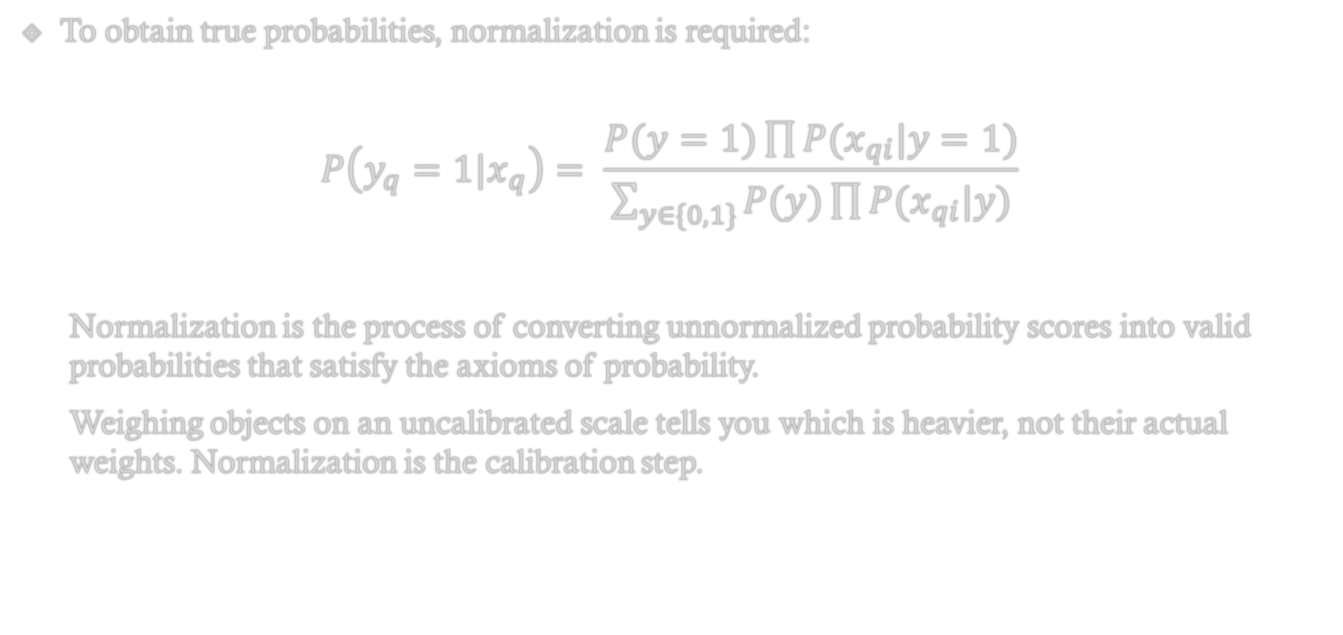
To obtain true probabilities, normalization is required:
$$P\left(y_{q}=1|x_{q}\right)= \frac{P(y=1)\prod{P(x_{qi}|y=1)}}{\sum_{y∈\{0,1\}}{P(y)\prod{P(x_{qi}|y)}}}$$
Normalization is the process of converting unnormalized probability scores into valid probabilities that satisfy the axioms of probability.
Weighing objects on an uncalibrated scale tells you which is heavier, not their actual weights. Normalization is the calibration step.

Slide 9
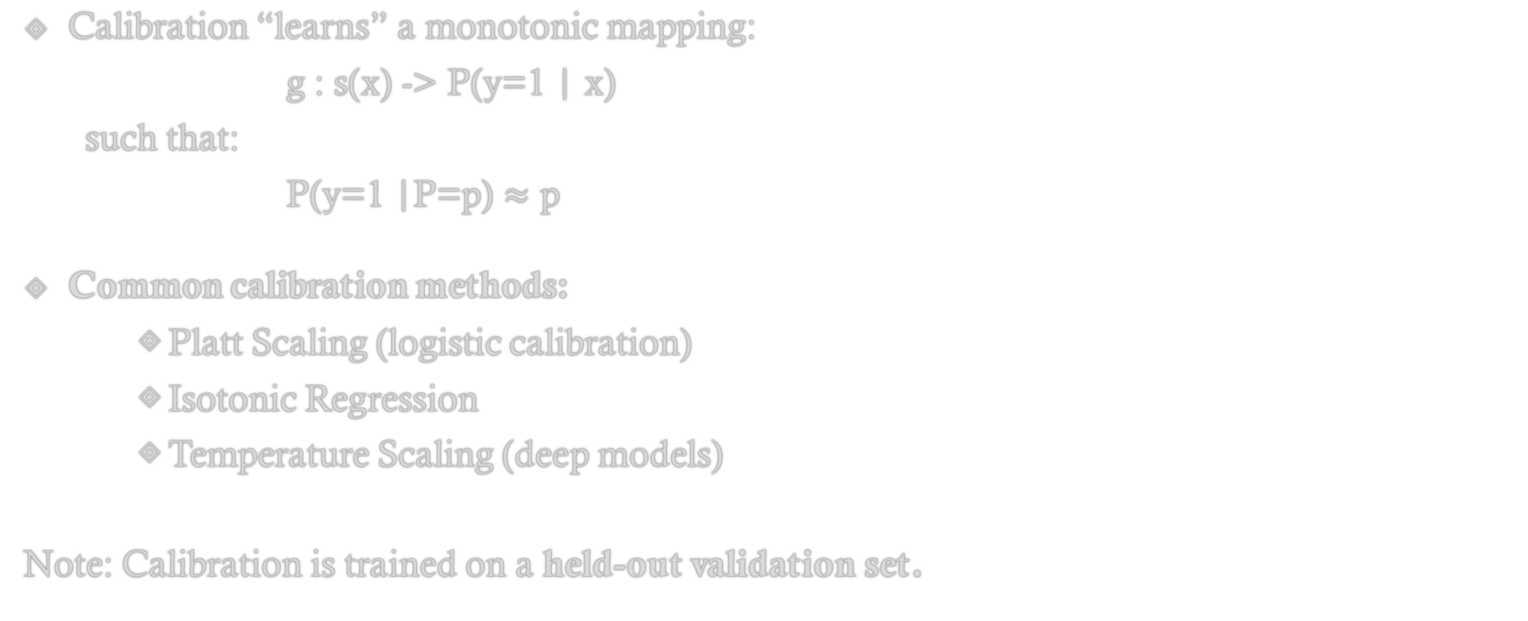
What Calibration Means
Calibration “learns” a monotonic mapping:
g : s(x) -> P(y=1 | x)
such that:
P(y=1 |P=p) $≈$ p
Common calibration methods:
Platt Scaling (logistic calibration)
Isotonic Regression
Temperature Scaling (deep models)
Note: Calibration is trained on a held-out validation set.

Slide 10
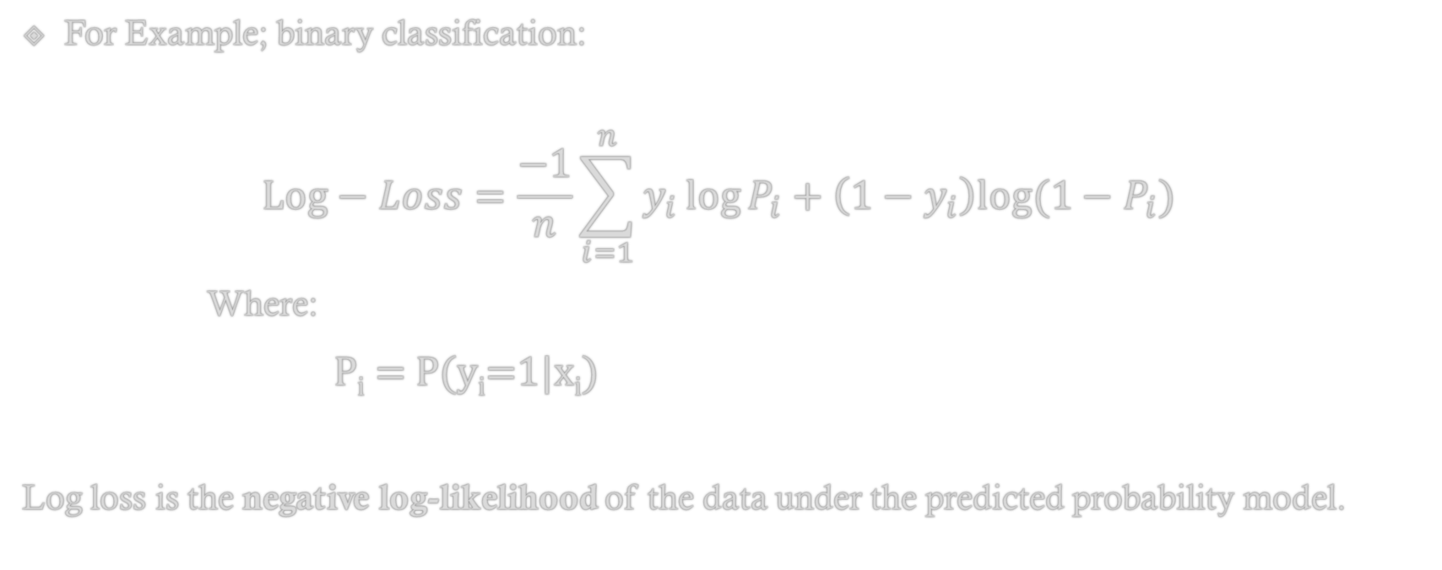
Why Exact Probability Is Needed: Log Loss
For Example; binary classification:
$$Log−Loss=\frac{−1}{n}\sum_{i=1}^{n}{y_{i}\log{P_{i}+\left(1−y_{i}\right)log⁡(1−P_{i})}}$$
Where:
P_{i} = P(y_{i}=1|x_{i})
Log loss is the negative log-likelihood of the data under the predicted probability model.

Slide 11
Consequence of Miscalibration
Two models can have identical accuracy
The model with better-calibrated probabilities will have lower log loss
Overconfident wrong predictions are penalized exponentially

Slide 12
Final Prediction Pipeline
Train base model: x_q -> f(x_q) = s_q
Apply calibration model: s_q -> g(s_q)
Obtain calibrated probabilities: P(y_q=1 | x_q), P(y_q=0 | x_q)
Use calibrated probabilities for:
Log loss computation
Risk-aware decision making
Threshold selection

Slide 13
Section Summary
Calibration is required because log loss and probabilistic decision-making assume access to true posterior probabilities, while most classifiers only produce uncalibrated scores.

Slide 14
Calibration Plot
What are Calibration Plots?
Construction of Calibration Plots.
Plotting and Interpretation.
Need for Sorting and Binning.
Use in Calibration.

Slide 15
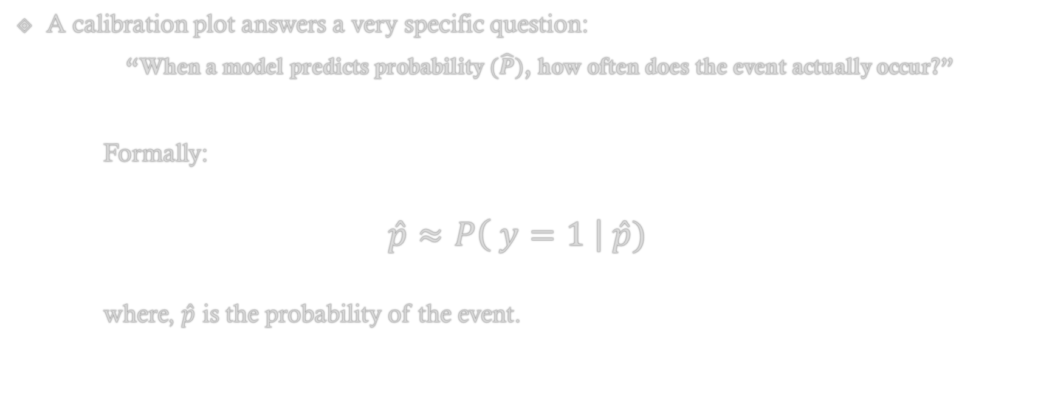
What is a Calibration Plot?
A calibration plot answers a very specific question:
“When a model predicts probability $(\hat{P})$, how often does the event actually occur?”
Formally:
$$\hat{p}≈P\left( y=1 \right| \hat{p})$$
where, $\hat{p}$ is the probability of the event.

Slide 16
Formal Construction of Calibration Plot

Slide 17
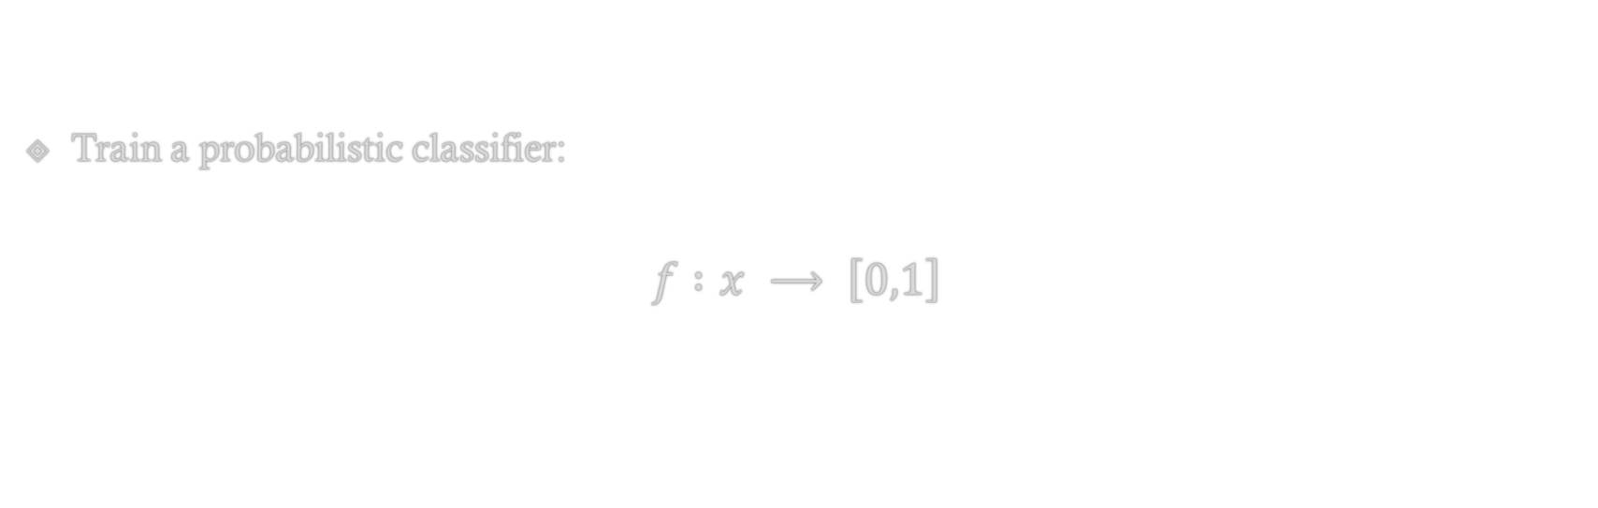
Step 0: Model
Train a probabilistic classifier:
$$f :x ⟶ \left[0,1\right]$$

Slide 18

Step 1: Create Calibration Dataset$(D_{CV})$
For each sample $x_{i}∈D_{cv}$:
$${\hat{y}}_{i}=f\left(x_{i}\right), y_{i}∈\left\{0,1\right\}$$
(x_{i}) | (ŷ_{i}) | (y_{i})
(x₁) | 0.12 | 0
(x₂) | 0.83 | 1
... | ... | ...

Slide 19
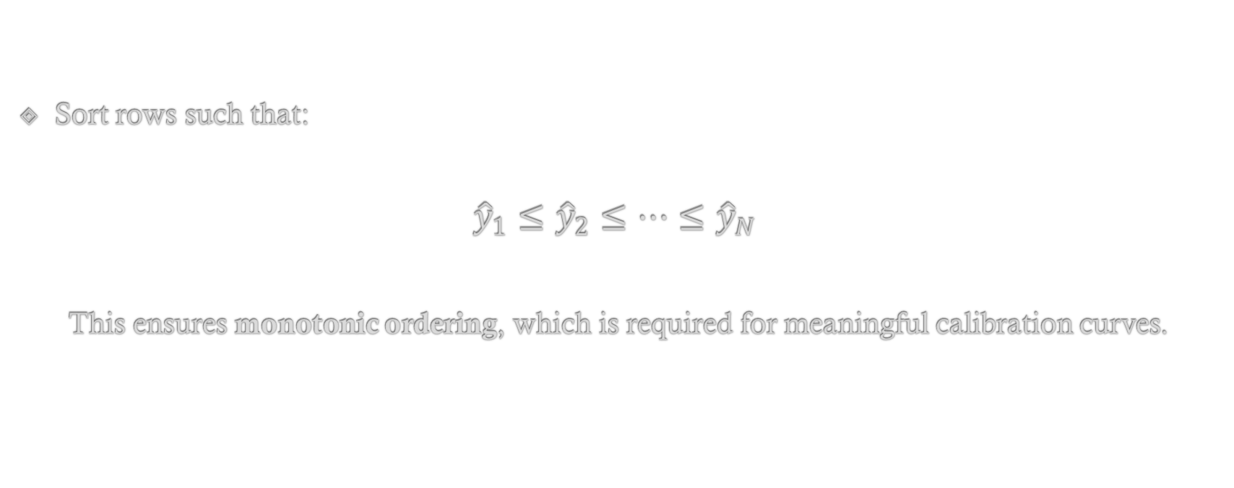
Step 2: Sort by Predicted Probability
Sort rows such that:
$${\hat{y}}_{1}≤{\hat{y}}_{2}≤⋯≤{\hat{y}}_{N}$$
This ensures monotonic ordering, which is required for meaningful calibration curves.

Slide 20
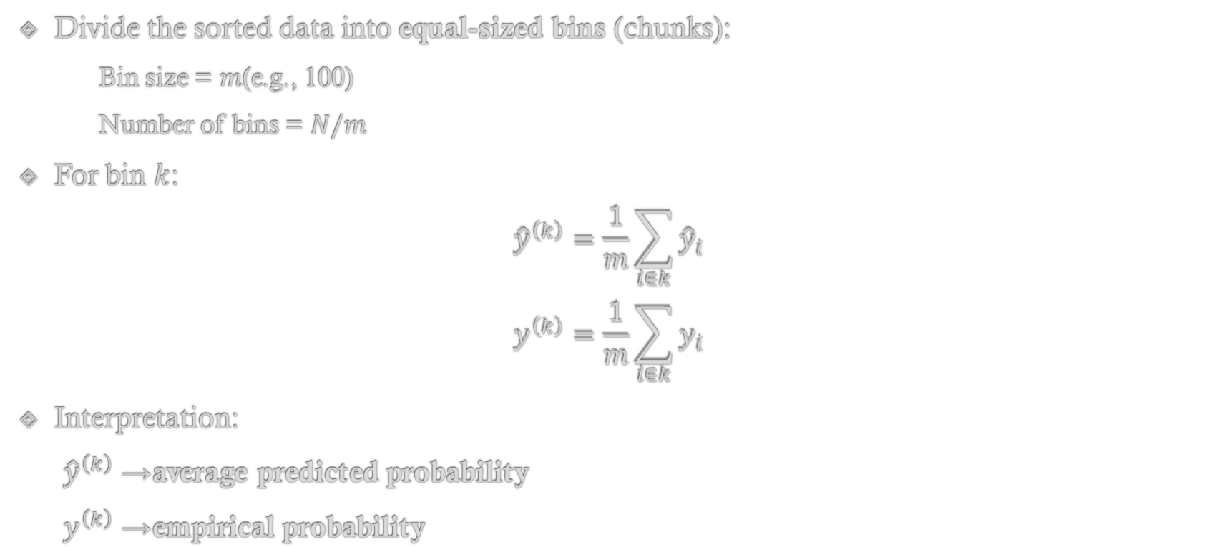
Step 3: Binning the Predictions
Divide the sorted data into equal-sized bins (chunks):
Bin size = $m$(e.g., 100)
Number of bins = $N/m$
For bin $k$:
$${\hat{y}}^{\left(k\right)}=\frac{1}{m}\sum_{i∈k}{{\hat{y}}_{i}}$$
$$y^{\left(k\right)}=\frac{1}{m}\sum_{i∈k}{y_{i}}$$
Interpretation:
${\hat{y}}^{\left(k\right)}$→ average predicted probability
$y^{\left(k\right)}$→ empirical probability

Slide 21
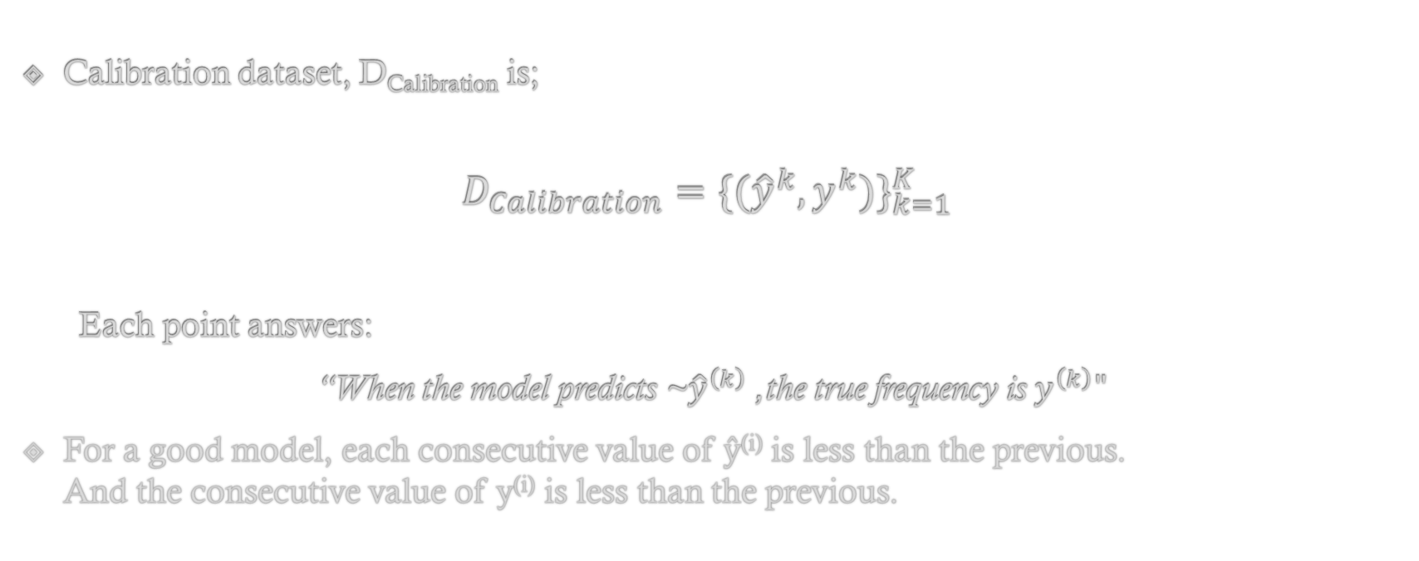
Step 4: Construct Calibration Set
Calibration dataset, D_{Calibration} is;
$$D_{Calibration}={\{({\hat{y}}^{k},y^{k})\}}_{k=1}^{K}$$
Each point answers:
“When the model predicts ~${\hat{y}}^{\left(k\right)}$, the true frequency is $y^{\left(k\right)}"$
For a good model, each consecutive value of ŷ^{(i)} is less than the previous. And the consecutive value of y^{(i)} is less than the previous.

Slide 22
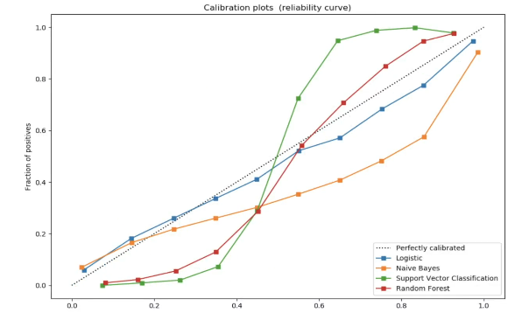
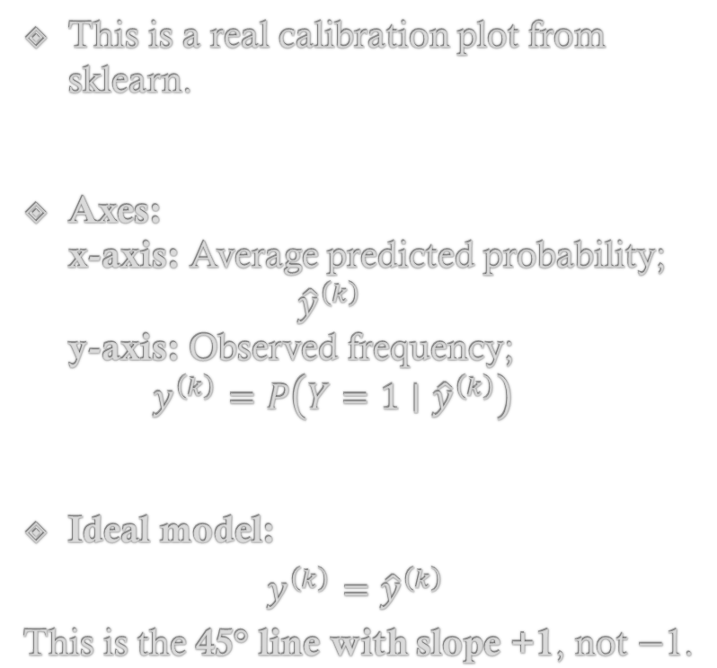
A Calibration Plot
This is a real calibration plot from sklearn.
Axes: x-axis: Average predicted probability; ${\hat{y}}^{\left(k\right)}$ y-axis: Observed frequency; $y^{\left(k\right)}=P\left(Y=1∣{\hat{y}}^{\left(k\right)}\right)$
Ideal model:
$$y^{\left(k\right)}={\hat{y}}^{\left(k\right)}$$ This is the 45° line with slope +1, not −1.

Slide 23
The Meaning of the Lines
Curve Position | Meaning
Below diagonal | Overconfident
Above diagonal | Underconfident
Zig-zag | High variance / small bins
Smooth monotonic | Well-calibrated

Slide 24
Why is Sorting and Binning necessary?
Think of this as a physical measurement analogy:
Sorting = arranging thermometer readings
Binning = averaging repeated measurements
Plotting = checking if the thermometer reports true temperature
Without binning:
The plot becomes noise-dominated
Empirical probabilities are undefined

Slide 25
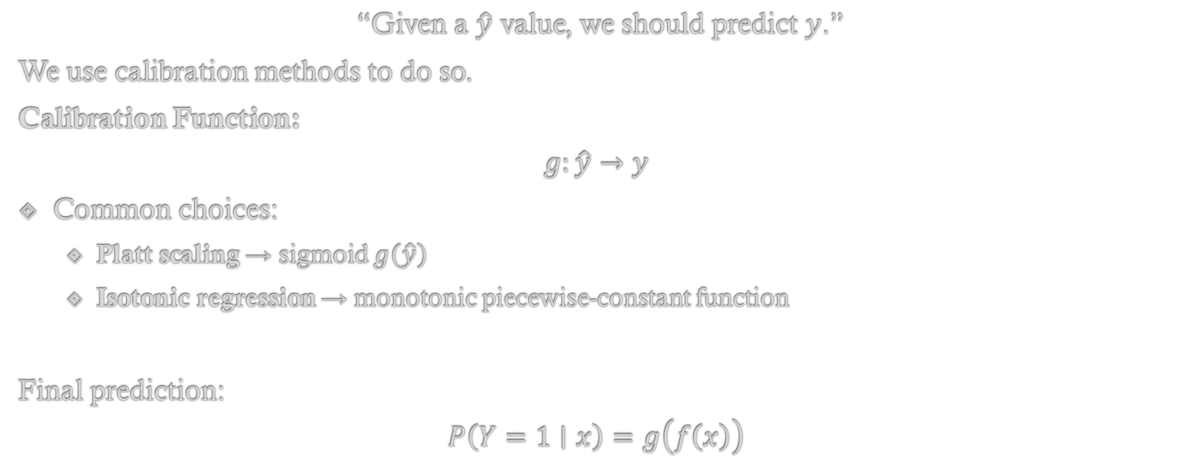
Using the Plot for Calibration
“Given a $\hat{y}$ value, we should predict $y$.”
We use calibration methods to do so.
Calibration Function:
$$g:\hat{y}→y$$
Common choices:
Platt scaling → sigmoid $g\left(\hat{y}\right)$
Isotonic regression → monotonic piecewise-constant function
Final prediction:
$$P\left(Y=1∣x\right)=g\left(f\left(x\right)\right)$$

Slide 26
Section Summary
A calibration plot compares predicted probabilities with empirical outcome frequencies by binning predictions and plotting average predicted probability versus observed class frequency.
A perfectly calibrated model lies on the 45-degree line.
Calibration curves are monotonic and form the basis for probability correction using Platt scaling or isotonic regression.

Slide 27
Platt Scaling / Sigmoidal Calibration
What is Pratt Scaling?
The Parameters of Pratt Scaling
Necessary Assumptions for Pratt Scaling
Limitations of Pratt Scaling

Slide 28
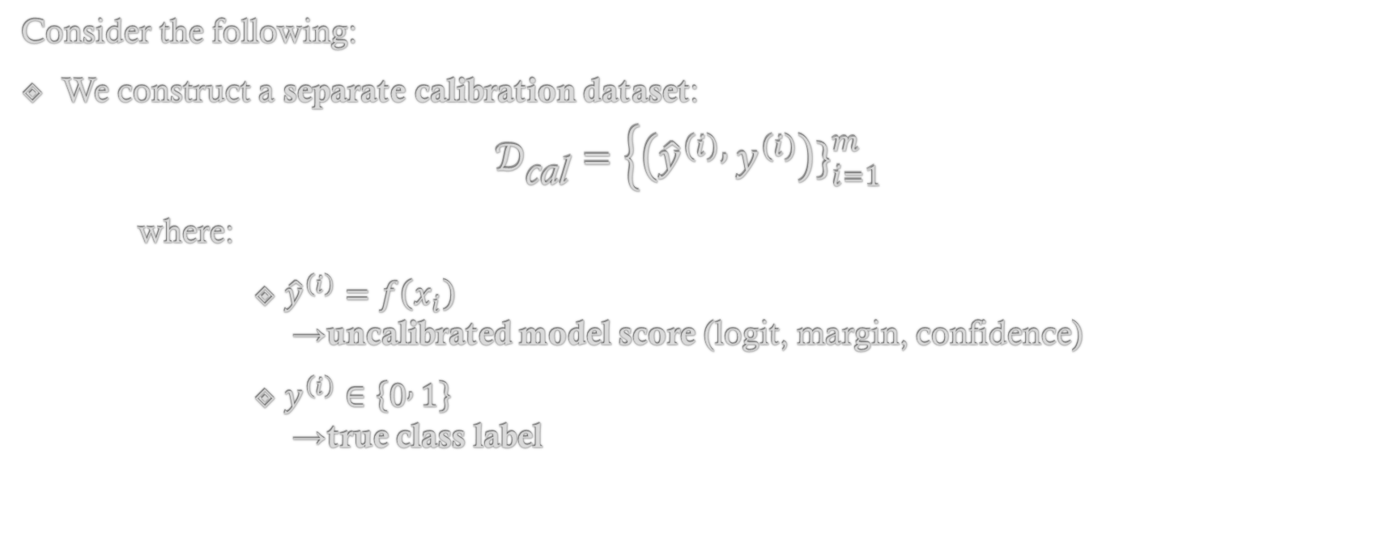
Learning through Example
Consider the following:
We construct a separate calibration dataset:
$$𝒟_{\text{cal}}=\left\{\left({\hat{y}}^{\left(i\right)} , y^{\left(i\right)}\right){\left.\}\right.}_{i=1}^{m}\right.$$
where:
${\hat{y}}^{\left(i\right)}=f\left(x_{i}\right)$ → uncalibrated model score (logit, margin, confidence)
$y^{\left(i\right)}∈\left\{0 , 1\right\}$ → true class label

Slide 29
Plotting
When we plot:
x-axis: predicted score (or binned score)
y-axis: empirical frequency of class 1
we often observe an S-shaped (sigmoidal) curve.
This suggests:
P(y=1 | ŷ) ≈ sigmoid (ŷ)
This motivates sigmoidal calibration.

Slide 30
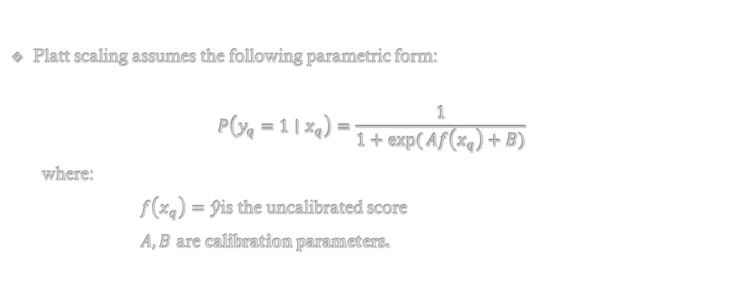
Pratt Scaling Model
Platt scaling assumes the following parametric form:
$$P\left(y_{q}=1∣x_{q}\right)=\frac{1}{1+\exp{(}Af\left(x_{q}\right)+B)}$$
where:
$f\left(x_{q}\right)=\hat{y}$is the uncalibrated score
$A,B$ are calibration parameters.

Slide 31
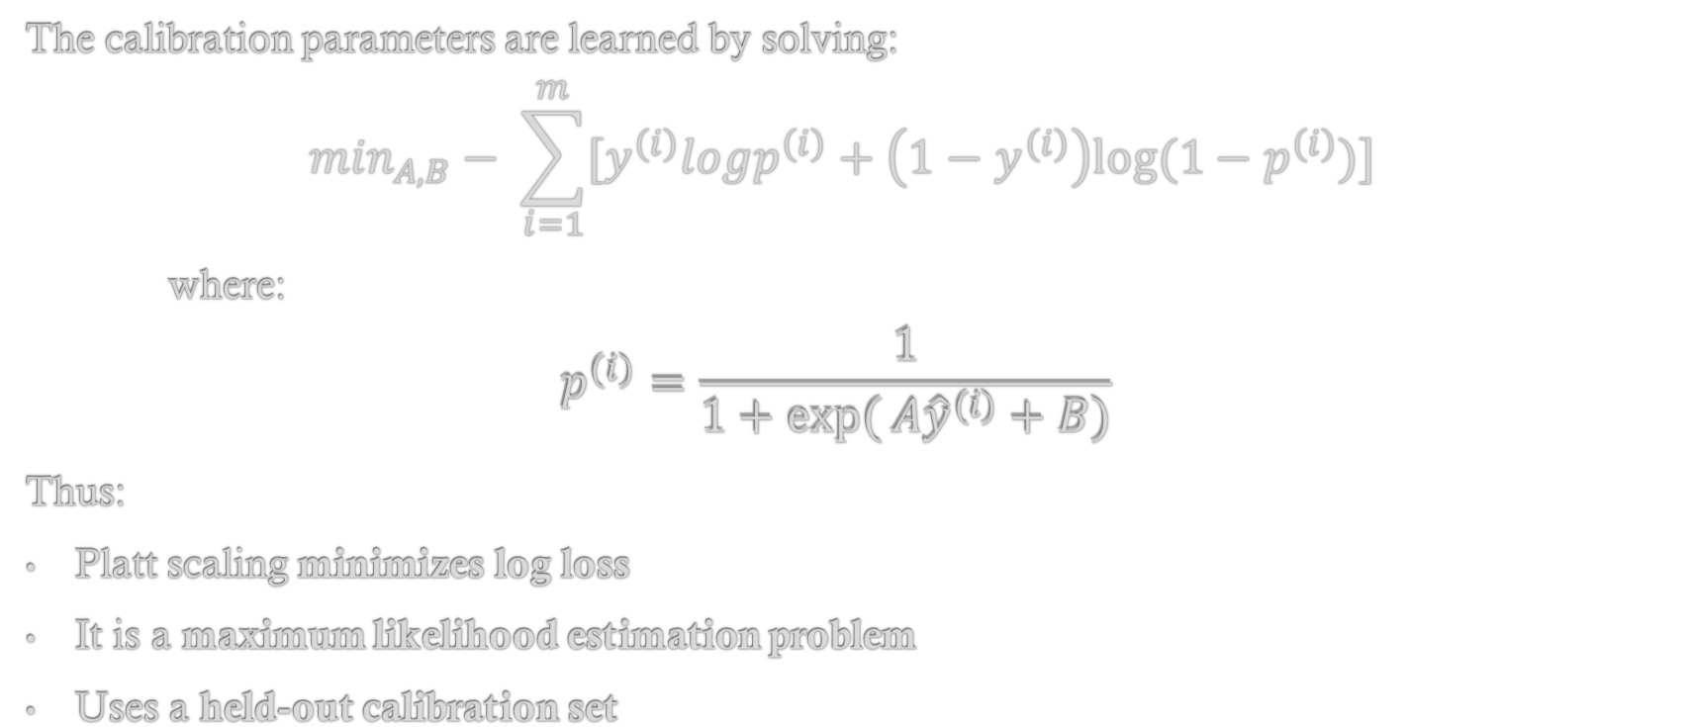
The Parameters; A & B
The calibration parameters are learned by solving:
$$\min_{A,B}− \sum_{i=1}^{m}{[y^{\left(i\right)}logp^{\left(i\right)}+\left(1−y^{\left(i\right)}\right)log⁡(1−p^{\left(i\right)})]}$$
where:
$$p^{(i)}=\frac{1}{1+\exp{(}A{\hat{y}}^{(i)}+B)}$$
Thus:
Platt scaling minimizes log loss
It is a maximum likelihood estimation problem
Uses a held-out calibration set

Slide 32
Necessary Assumptions
Platt scaling assumes:
The model scores are monotonically related to true probabilities
The plotted “reliability” curve is approximately sigmoidal.
There is sufficient calibration data.
If these assumptions fail, the fit is poor.

Slide 33
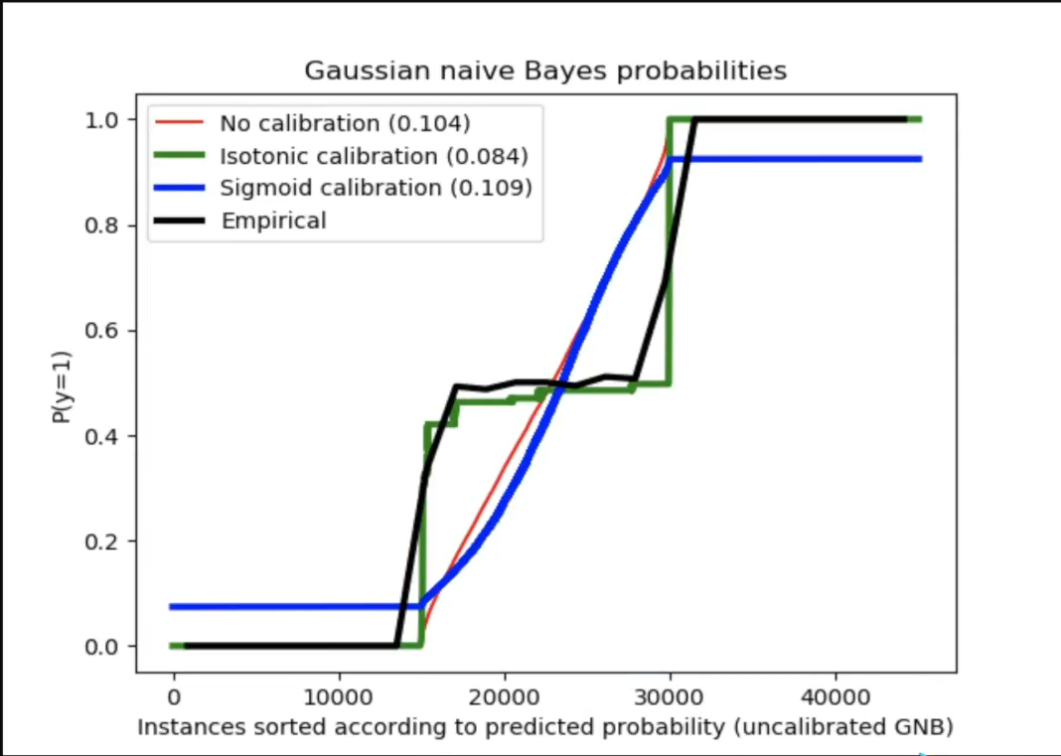
A Problem
When the empirical calibration curve:
Is step-like
Has flat regions
Is highly non-sigmoidal
then:
The fitted sigmoid cannot follow the data
The calibrated probabilities deviate significantly from reality
Log loss may even worsen

Slide 34
Limitation of Platt Scaling
Platt scaling only works well when the empirical reliability curve is approximately sigmoidal.
It is:
Low variance
Parametric
Bias-prone when the assumption fails

Slide 35
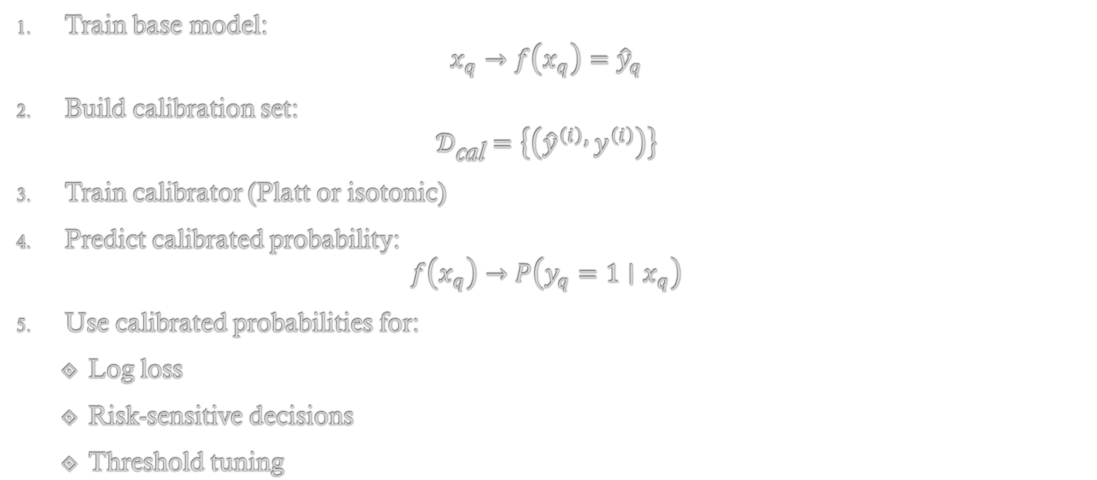
End-to-End Training Pipeline
Train base model: $x_{q}→f\left(x_{q}\right)={\hat{y}}_{q}$
Build calibration set: $𝒟_{\text{cal}}=\left\{\left({\hat{y}}^{\left(i\right)} , y^{\left(i\right)}\right)\right\}$
Train calibrator (Platt or isotonic)
Predict calibrated probability: $f\left(x_{q}\right)→P\left(y_{q}=1∣x_{q}\right)$
Use calibrated probabilities for:
Log loss
Risk-sensitive decisions
Threshold tuning

Slide 36
Section Summary
Platt scaling converts uncalibrated model scores into probabilities by fitting a sigmoid function using log-loss minimization, but it is effective only when the empirical reliability curve is approximately sigmoidal; otherwise, isotonic regression is preferred.

Slide 37
Isotonic Calibration
What is Isotonic Calibration?
When is Isotonic Calibration used?
Determination of Thresholds and Segments
Need for Data

Slide 38
When to use Isotonic Calibration?
Isotonic calibration is applied when the empirical calibration (reliability) plot does not resemble a sigmoidal curve.
This typically occurs when:
Model scores are discretized or clustered
The reliability curve is step-like
Platt (sigmoidal) scaling produces large calibration error

Slide 39
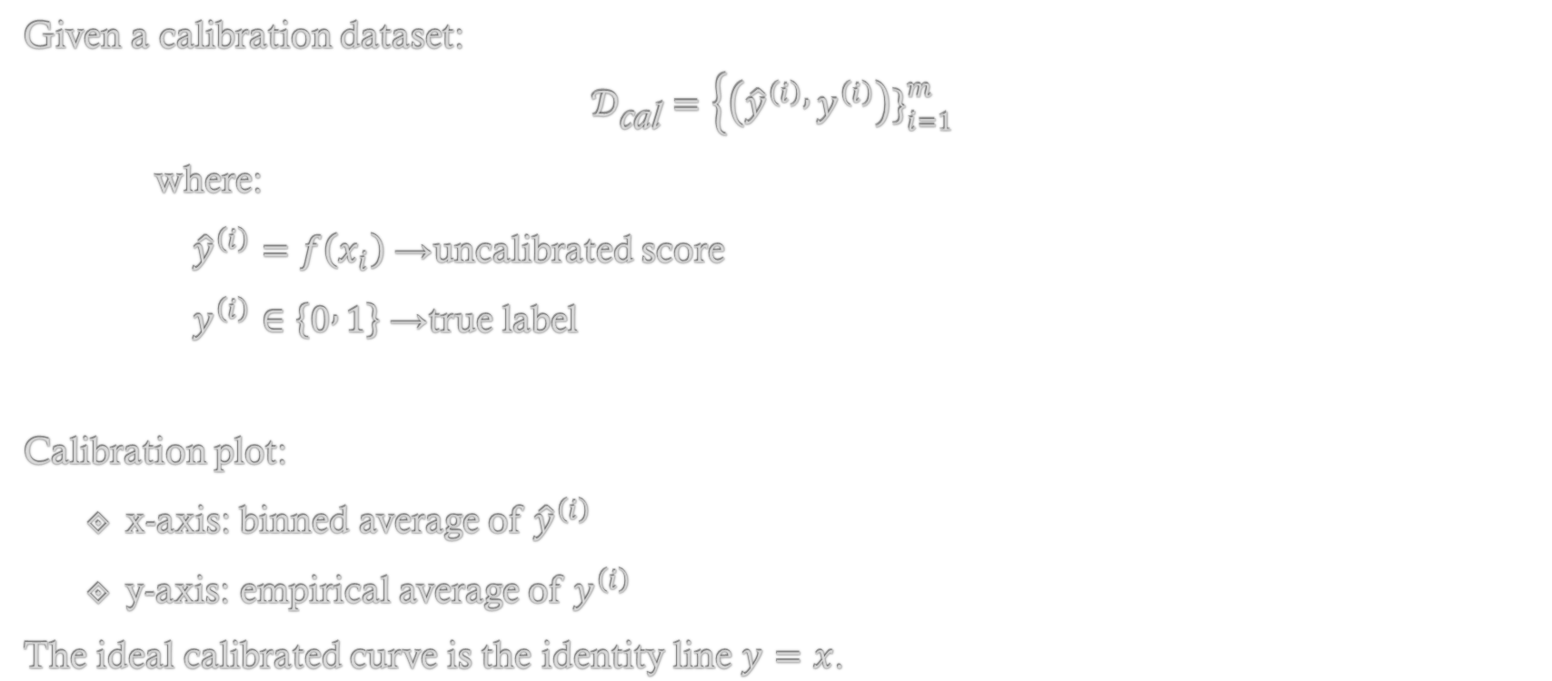
Calibration Dataset and Axes
Given a calibration dataset:
$$𝒟_{\text{cal}}=\left\{\left({\hat{y}}^{\left(i\right)} , y^{\left(i\right)}\right){\left.\}\right.}_{i=1}^{m}\right.$$
where:
${\hat{y}}^{\left(i\right)}=f\left(x_{i}\right)$→ uncalibrated score
$y^{\left(i\right)}∈\left\{0 , 1\right\}$→ true label
Calibration plot:
x-axis: binned average of ${\hat{y}}^{\left(i\right)}$
y-axis: empirical average of $y^{\left(i\right)}$
The ideal calibrated curve is the identity line $y=x$.

Slide 40
Why Isotonic Calibration is Needed
The empirical calibration curve (Yellow) is non-sigmoidal
A fitted sigmoid (Orange) cannot follow abrupt changes
This causes large gaps between predicted and observed probabilities
Hence, a parametric sigmoid is too restrictive.

Slide 41
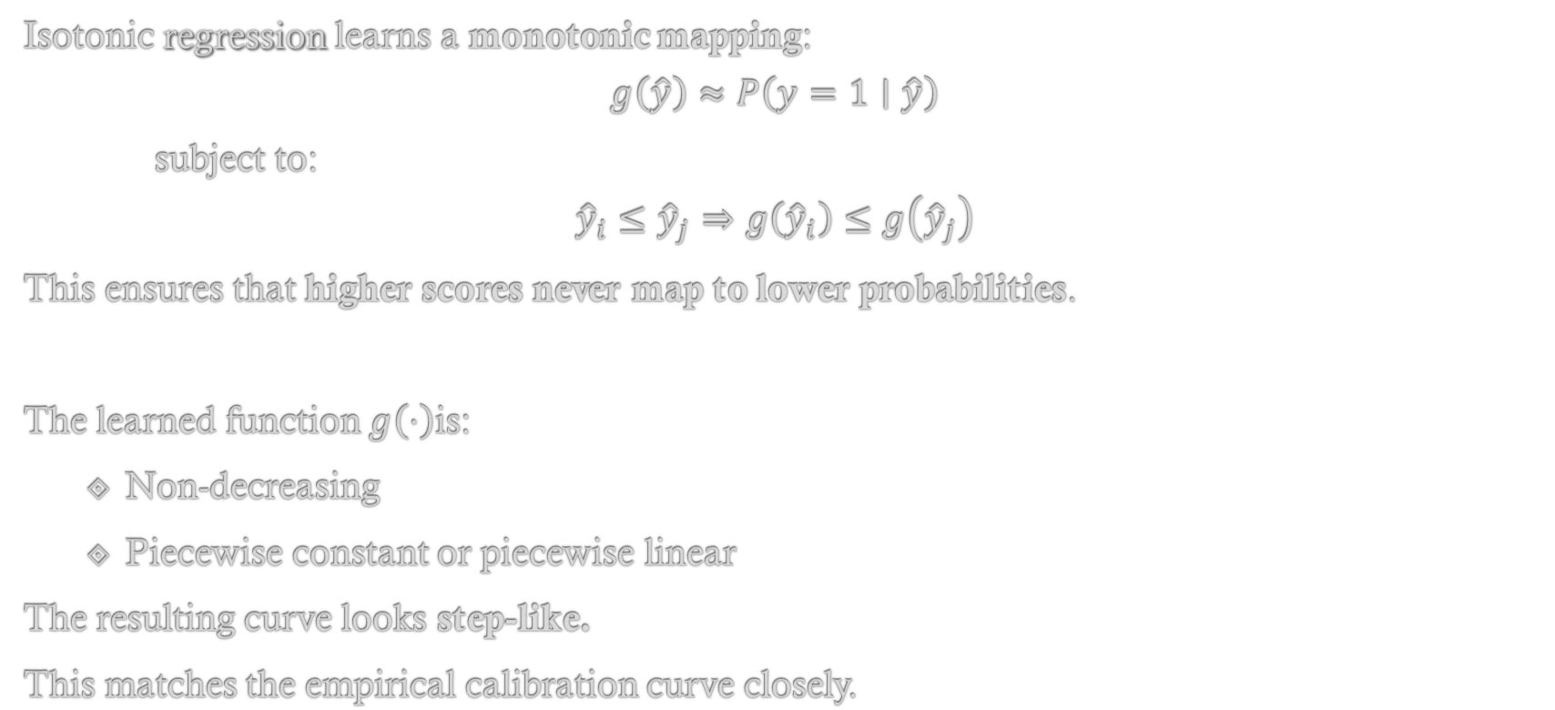
Isotonic Regression Model
Isotonic regression learns a monotonic mapping:
$$g\left(\hat{y}\right)≈P\left(y=1∣\hat{y}\right)$$
subject to:
$${\hat{y}}_{i}≤{\hat{y}}_{j}⇒g\left({\hat{y}}_{i}\right)≤g\left({\hat{y}}_{j}\right)$$
This ensures that higher scores never map to lower probabilities.
The learned function $g\left(⋅\right)$is:
Non-decreasing
Piecewise constant or piecewise linear
The resulting curve looks step-like.
This matches the empirical calibration curve closely.

Slide 42
Determining Thresholds and Segments
The algorithm automatically determines:
Thresholds: (a₁, a₂, a₃, …..)
Line segments: (l₁, l₂, l₃, …..)
Each segment has:
l_{k}(ŷ) = m_{k}ŷ + b_{k}
There is no manual selection of thresholds.

Slide 43
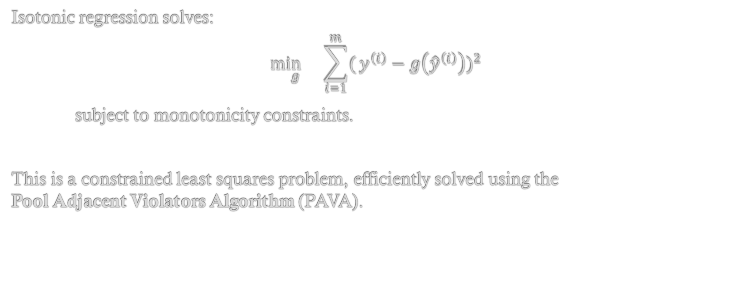
How to Optimize?
Isotonic regression solves:
$$\underset{g}{\min{}}\sum_{i=1}^{m}{(}y^{\left(i\right)}−g\left({\hat{y}}^{\left(i\right)}\right))^{2}$$
subject to monotonicity constraints.
This is a constrained least squares problem, efficiently solved using the Pool Adjacent Violators Algorithm (PAVA).
Notes:
- “Subject to monotonicity constraints” means the calibrated output must be non-decreasing with respect to the model’s score.
Without it, calibration could do something illogical, such as:
Model Score Calibrated Probability
0.60 0.70
0.65 0.55
This would mean “A more confident prediction becomes less likely”.
PAVA is the standard algorithm used to perform isotonic regression.
Whenever the monotonic order is violated, PAVA merges neighbouring points until the violation disappears.

Slide 44
Why Isotonic Regression Needs More Data
Non-parametric → higher variance
Many free parameters (thresholds + segments)
Risk of overfitting on small datasets
Therefore:
Large calibration set → isotonic regression
Small calibration set → Platt scaling

Slide 45
Platt vs Isotonic
Aspect | Platt Scaling | Isotonic Regression
Model | Parametric sigmoid | Non-parametric monotonic
Assumption | Sigmoidal shape | Only monotonicity
Data requirement | Low | High
Variance | Low | High
Flexibility | Limited | High

Slide 46
Section Summary
Isotonic calibration uses monotonic regression to map uncalibrated model scores to probabilities when the empirical calibration curve is non-sigmoidal, at the cost of requiring larger calibration datasets.

Slide 47
Can Isotonic Regression Worsen Accuracy?
Isotonic calibration can worsen accuracy because it shifts probabilities across decision thresholds, but it improves log loss because it corrects confidence errors and reduces overconfident wrong predictions.
Isotonic preserves ranking, but accuracy depends on absolute values.
Accuracy worsens, log loss improves.
Case | Before | After Isotonic | Accuracy | Log Loss
Prediction | 0.51 | 0.49 | ❌ (worse) | ↓
Log Loss | - log(0.49) = 0.71 | - log(0.51) = 0.67

Slide 48
Sklearn Example
A sample code from Sci kit learn.
Python Package:
https://scikit-learn.org/stable/modules/generated/sklearn.calibration.CalibratedClassifierCV.html
Code from:
https://scikit-learn.org/stable/auto_examples/calibration/plot_calibration.html

Slide 49
RANSAC RANdom SAmple Consensus
What to do in the presence of Outliers?
Building Robust Models
Linear Regression Example

Slide 50
Dealing with Outliers
Can we build a robust model when data contains outliers?
Standard regression methods are sensitive to outliers.
Outliers exert disproportionately large influence.
Leads to biased and unstable models.

Slide 51

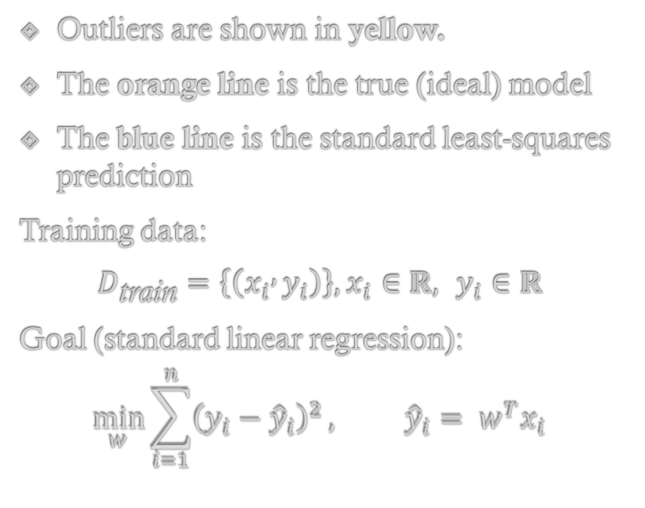

Example, A linear Regression Problem
Outliers are shown in yellow.
The orange line is the true (ideal) model
The blue line is the standard least-squares prediction
Training data:
$$D_{\text{train}}=\left\{\left(x_{i} , y_{i}\right)\right\}, x_{i}∈ℝ, y_{i}∈ℝ$$
Goal (standard linear regression):
$$\min_{w}{\sum_{i=1}^{n}{{\left(y_{i}−{\hat{y}}_{i}\right)}^{2}}}, {\hat{y}}_{i}= w^{T}x_{i}$$

Slide 52
Failure of Least Square
Squared error magnifies large residuals.
Far-away outliers exert disproportionately high leverage.
The resulting model is non-robust.
The fitted separator (line/plane) is pulled toward outliers.

Slide 53
RANSAC
Instead of fitting a model using all data points, RANSAC repeatedly fits models using small random subsets, then keeps the model that agrees with the largest number of points (the consensus set).

Slide 54
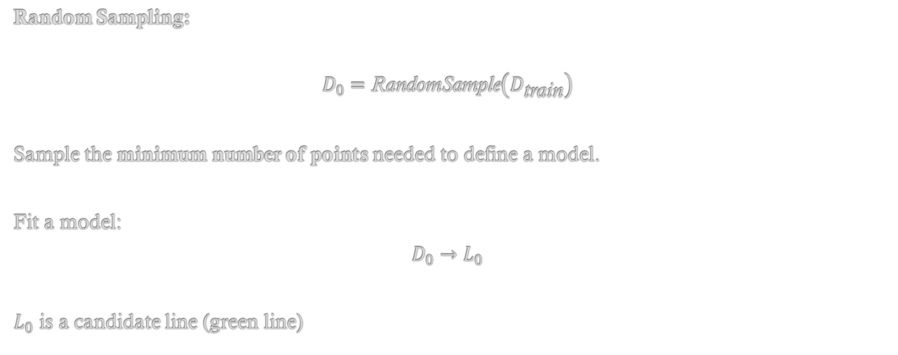
Algorithm; Step 1
Random Sampling:
$$D_{0}=\text{RandomSample}\left(D_{\text{train}}\right)$$
Sample the minimum number of points needed to define a model.
Fit a model:
$$D_{0}→L_{0}$$
$L_{0}$ is a candidate line (green line)

Slide 55
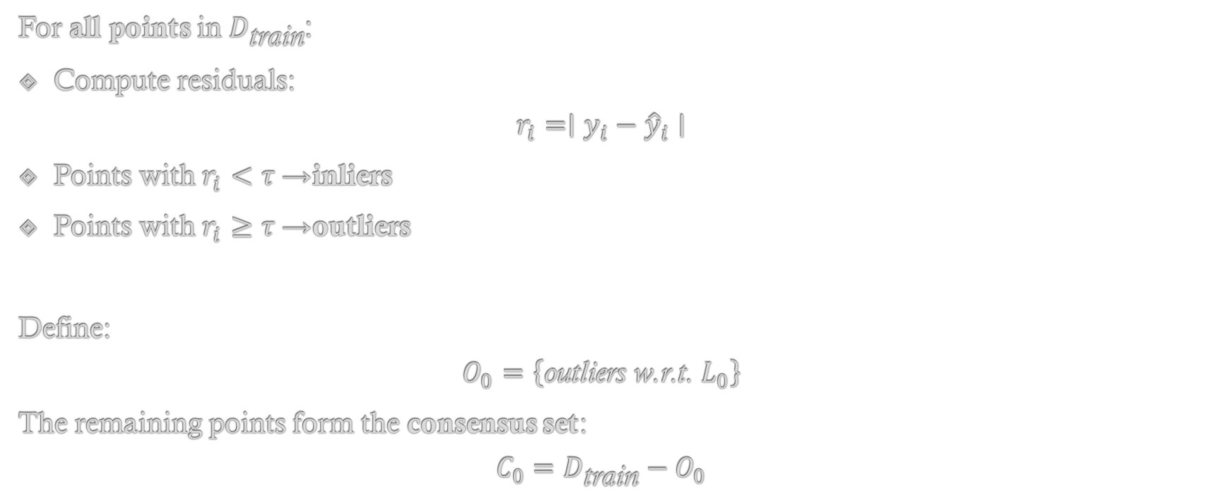
Step 2: Inlier/Outlier Classification
For all points in $D_{\text{train}}$:
Compute residuals:
$$r_{i}=∣y_{i}−{\hat{y}}_{i}∣$$
Points with $r_{i}<τ$→ inliers
Points with $r_{i}≥τ$→ outliers
Define:
$$O_{0}=\left\{\text{outliers} \text{w}\text{.}\text{r}\text{.}\text{t}\text{. }L_{0}\right\}$$
The remaining points form the consensus set:
$$C_{0}=D_{\text{train}}−O_{0}$$

Slide 56
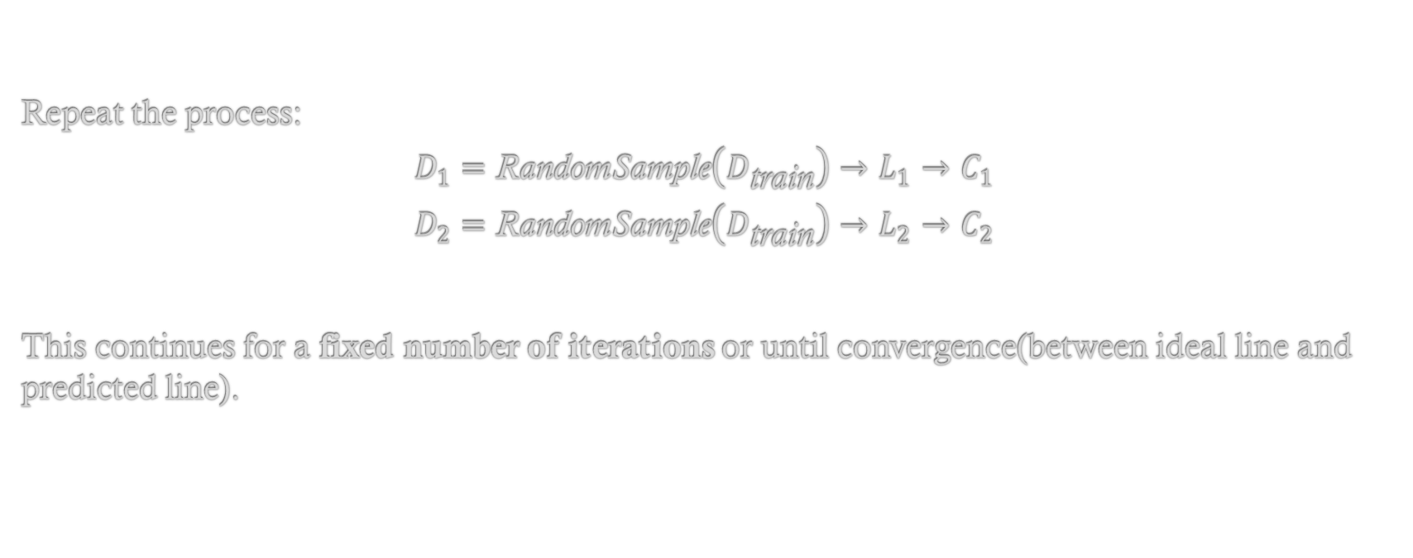
Step 3: Repeat with New Random Samples
Repeat the process:
$$D_{1}=\text{RandomSample}\left(D_{\text{train}}\right)→L_{1}→C_{1}$$
$$D_{2}=\text{RandomSample}\left(D_{\text{train}}\right)→L_{2}→C_{2}$$
This continues for a fixed number of iterations or until convergence(between ideal line and predicted line).

Slide 57
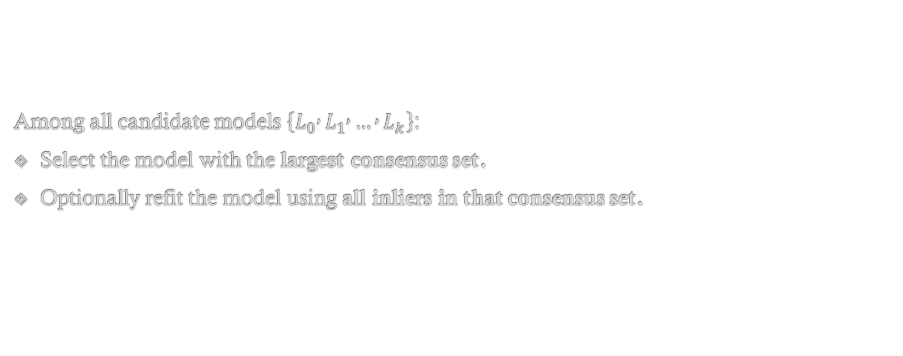
Step 4: Model Selection (Consensus Maximization)
Among all candidate models $\left\{L_{0} , L_{1} , … , L_{k}\right\}$:
Select the model with the largest consensus set.
Optionally refit the model using all inliers in that consensus set.

Slide 58
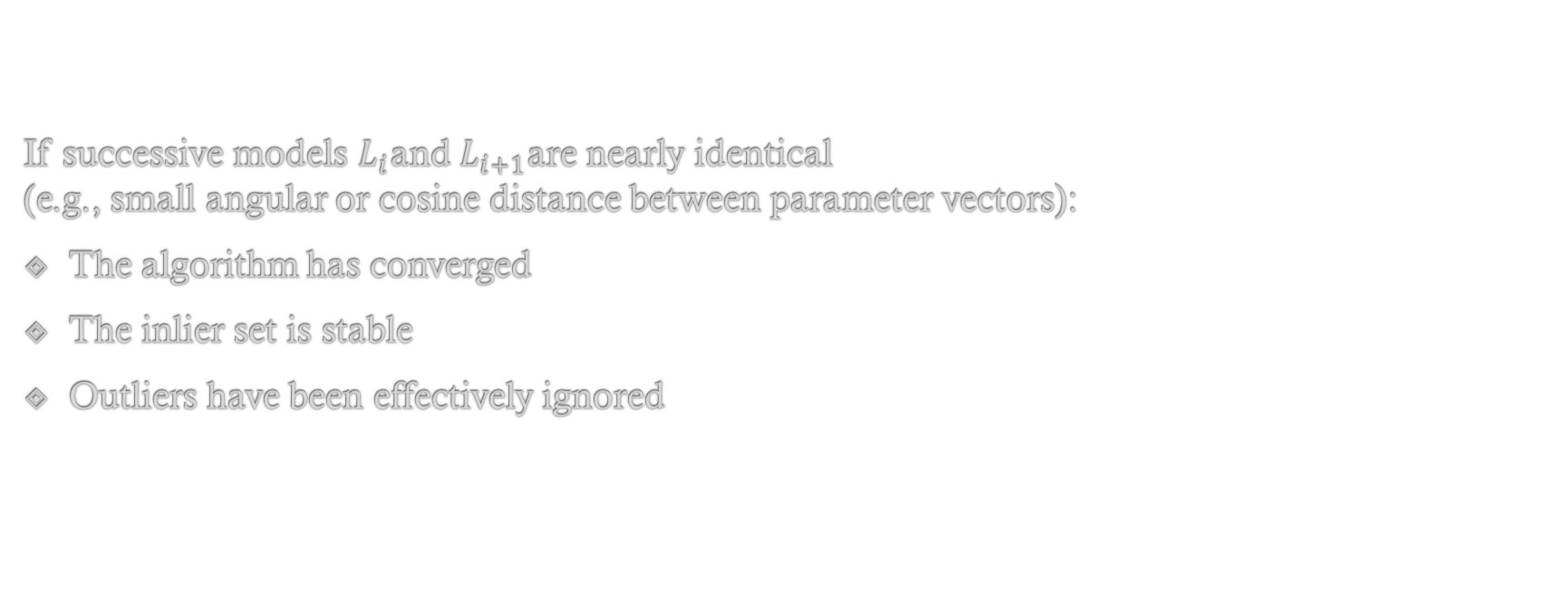
Step 5: Convergence Interpretation
If successive models $L_{i}$and $L_{i+1}$are nearly identical (e.g., small angular or cosine distance between parameter vectors):
The algorithm has converged
The inlier set is stable
Outliers have been effectively ignored

Slide 59
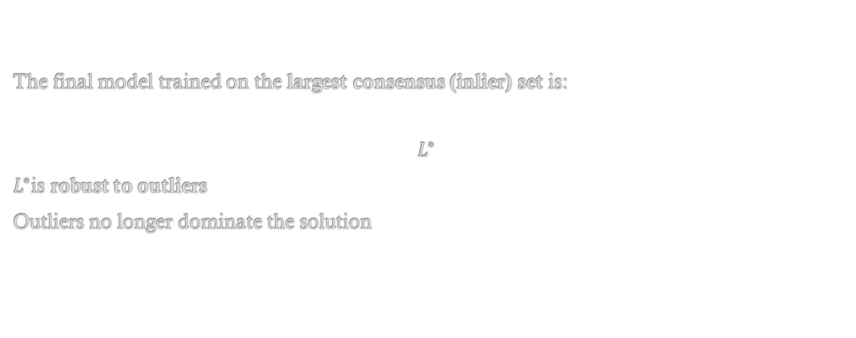
Finally…
The final model trained on the largest consensus (inlier) set is:
$$L^{∗}$$
$L^{∗}$is robust to outliers
Outliers no longer dominate the solution

Slide 60
Section Summary
Least squares minimizes error to all points, including outliers.
RANSAC maximizes agreement among most points.
Robustness comes from ignoring inconsistent data, not fitting it better.
RANSAC trades determinism for robustness

Slide 61
Productionizing a Model
What does that mean?
Training vs Runtime
Framework vs Custom
High-Throughput Production Systems

Slide 62
What is Productionization?
Productionizing is the process of taking a trained machine learning model and making it usable in a real system to serve predictions reliably, efficiently, and at scale.

Slide 63
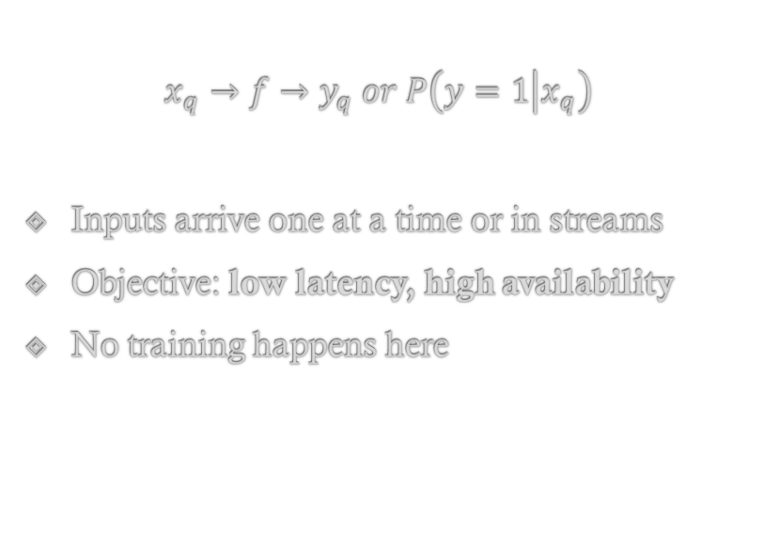
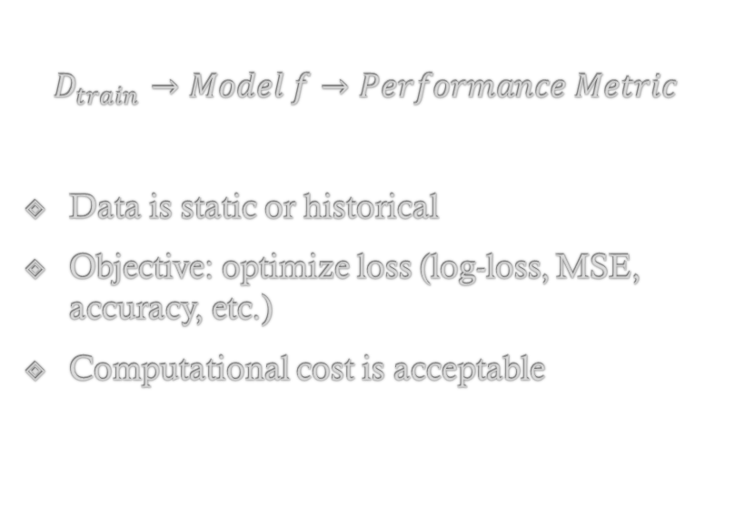
Conceptual Flow
Training phase (offline):
Runtime / Inference phase (online):
$$D_{train}→Model f→Performance Metric$$
Data is static or historical
Objective: optimize loss (log-loss, MSE, accuracy, etc.)
Computational cost is acceptable
$$x_{q}→f→y_{q} or P\left(y=1 | x_{q}\right)$$
Inputs arrive one at a time or in streams
Objective: low latency, high availability
No training happens here

Slide 64
Training vs Runtime
Aspect | Training | Runtime
Data | Large batches | Single query or small batch
Latency | Not critical | Extremely important
Compute | Heavy (CPU/GPU) | Lightweight
Updates | Frequent parameter updates | No parameter updates
Environment | Offline | Production box / server

Slide 65
Making a Model Runnable in Production
Option 1: Framework Based Deployment(scikit-learn)
This is the most common approach for prototypes and medium-scale systems.
Step 1: Train the Model
from sklearn import svm, datasets
iris = datasets.load_iris()
X, y = iris.data, iris.target
clf = svm.SVC(kernel='rbf’)
clf.fit(X, y)

Slide 66
Step 2: Persist (Serialize) the Model
Purpose: Save the trained model so it can be reused later without retraining.
Using pickle. import pickle
s = pickle.dumps(clf)
clf2 = pickle.loads(s)
Using joblib (recommended for large models)
import joblib
joblib.dump(clf, 'model.pkl’)
clf = joblib.load('model.pkl')

Slide 67
Step 3: Load Model in Production
Model file stored on disk (HDD/SSD).
Loaded into RAM once at service startup.
Used repeatedly for inference.

Slide 68
Framework Based: Pros and Cons
Pros
Cons
Simple.
Fast to implement.
Minimal engineering effort.
Python overhead.
Higher latency.
Not ideal for real-time, high-throughput systems

Slide 69
Custom Implementation (Performance-Critical Systems)
Used when:
Latency must be in microseconds
Throughput is extremely high
Python runtime is unacceptable
Core Idea:
Instead of shipping the entire ML framework, you extract model parameters and reimplement inference manually.

Slide 70
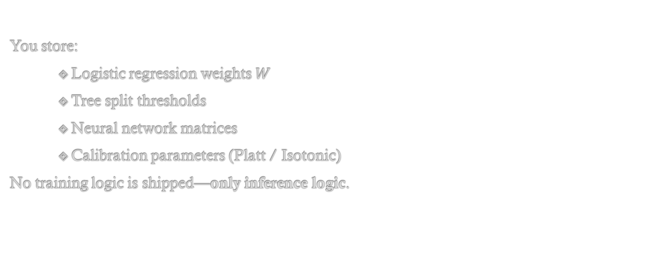
1. Parameter Storage
You store:
Logistic regression weights $W$
Tree split thresholds
Neural network matrices
Calibration parameters (Platt / Isotonic)
No training logic is shipped—only inference logic.

Slide 71
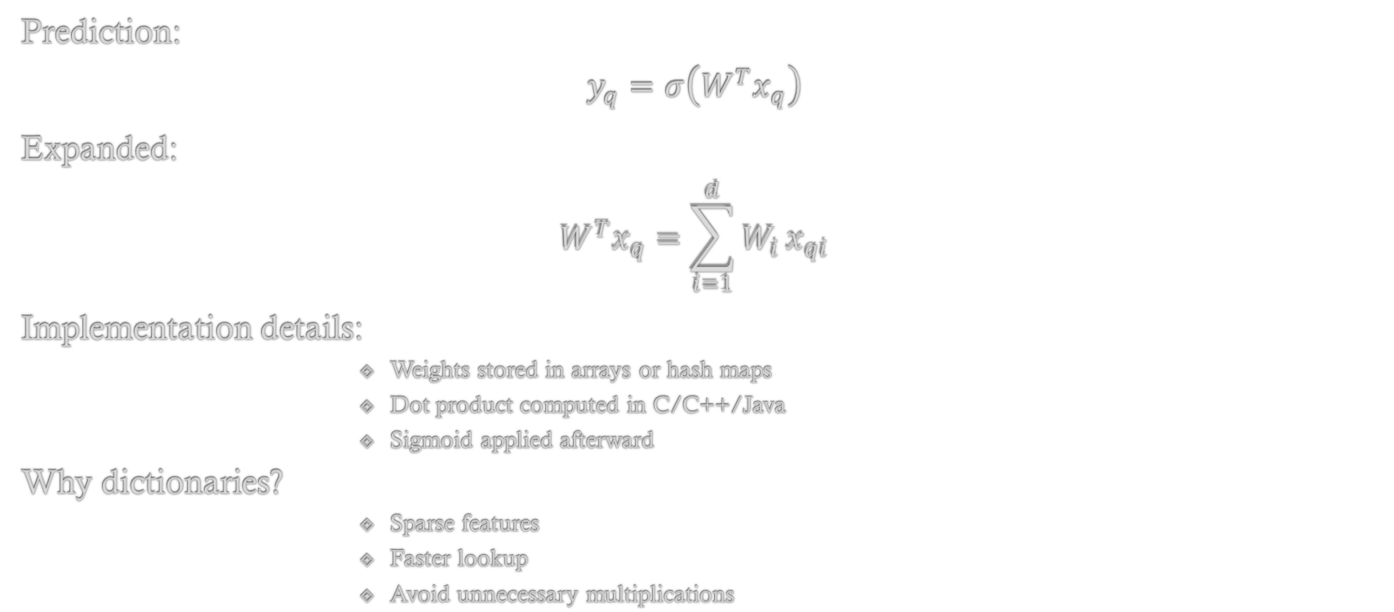
2. Logistic Regression Example
Prediction:
$$y_{q}=σ\left(W^{T}x_{q}\right)$$
Expanded:
$$W^{T}x_{q}=\sum_{i=1}^{d}{W_{i}}x_{qi}$$
Implementation details:
Weights stored in arrays or hash maps
Dot product computed in C/C++/Java
Sigmoid applied afterward
Why dictionaries?
Sparse features
Faster lookup
Avoid unnecessary multiplications

Slide 72
3. Decision Trees / Random Forests
Each tree is converted into nested conditionals:
if (x[3] <= 2.4) {
if (x[1] <= 1.7) return 0.12;
else return 0.43;
}
else {
return 0.91;
}
Random Forest:
Evaluate all trees
Average probabilities or vote

Slide 73
Custom Implementation
Pros
Cons
Extremely fast.
Predictable latency.
Language-agnostic runtime.
High engineering effort.
Harder to maintain.
Must ensure correctness manually.

Slide 74
High-Throughput Production Systems
When serving millions of predictions:
Key Techniques:
Load balancing
Distribute requests across CPUs or machines
Caching
Store frequently used weights and lookup tables in memory
Avoid repeated disk access
Warm models
Load models once at startup
Never reload per request
Batch inference
Group requests when possible

Slide 75
Section Summary
A trained model is not a production system. Productionizing is about latency, reliability, scalability, and maintainability.
scikit-learn → fast development
Custom inference → fast execution
Choosing between them is an engineering decision, not a modeling one.

Slide 76
Retraining Models Periodically
Performance Drops
Retraining Strategy
Cost vs Benefit

Slide 77
Need for Retraining
Machine learning models are trained on historical data under the assumption that future data will follow similar statistical patterns.
In real-world systems—especially domains like finance—this assumption rarely holds.
As time progresses, the environment changes, and models trained on past data gradually lose alignment with reality.
Periodic retraining is therefore a necessary operational practice, not an optional optimization.

Slide 78
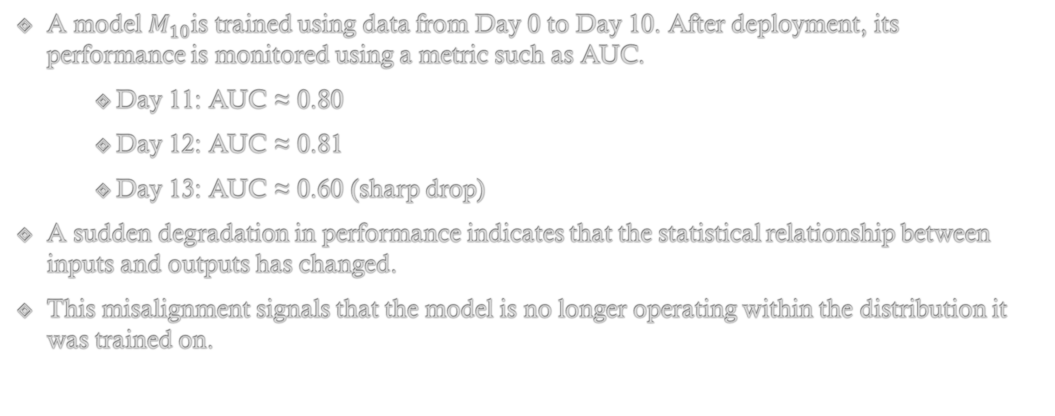
Example
A model $M_{10}$is trained using data from Day 0 to Day 10. After deployment, its performance is monitored using a metric such as AUC.
Day 11: AUC ≈ 0.80
Day 12: AUC ≈ 0.81
Day 13: AUC ≈ 0.60 (sharp drop)
A sudden degradation in performance indicates that the statistical relationship between inputs and outputs has changed.
This misalignment signals that the model is no longer operating within the distribution it was trained on.

Slide 79
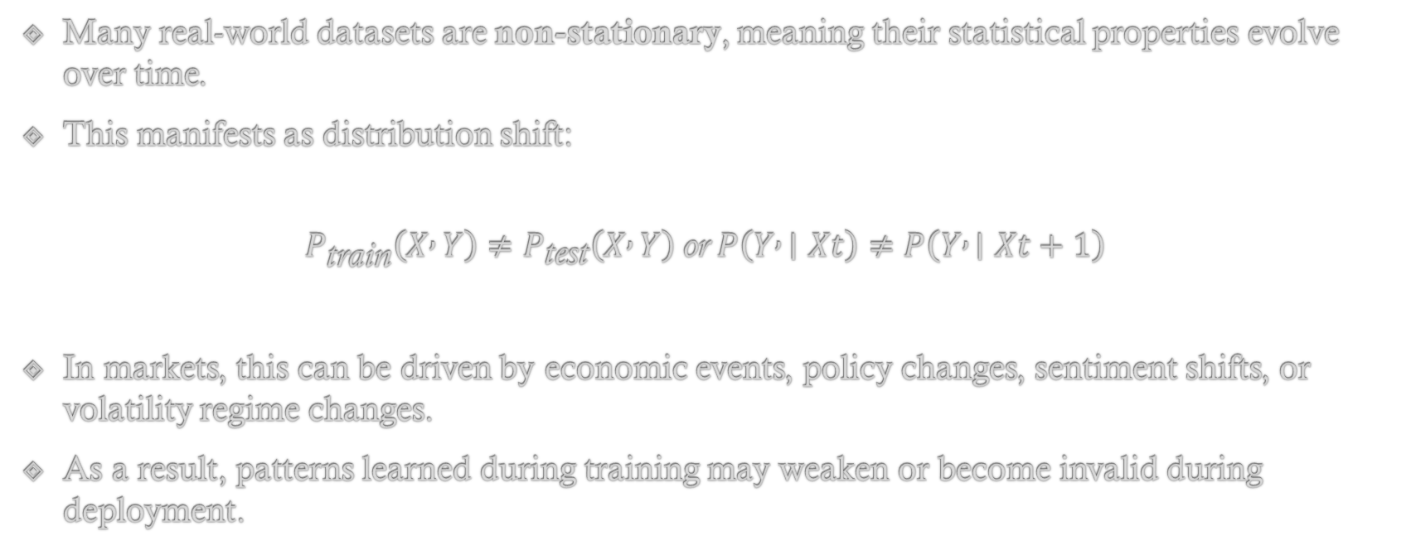
Non-Stationary Data and Distribution Shift
Many real-world datasets are non-stationary, meaning their statistical properties evolve over time.
This manifests as distribution shift:
$$P_{\text{train}}\left(X , Y\right)≠P_{\text{test}}\left(X , Y\right) \text{or} P\left(Y , ∣Xt\right)≠P\left(Y , ∣Xt+1\right)$$
In markets, this can be driven by economic events, policy changes, sentiment shifts, or volatility regime changes.
As a result, patterns learned during training may weaken or become invalid during deployment.

Slide 80
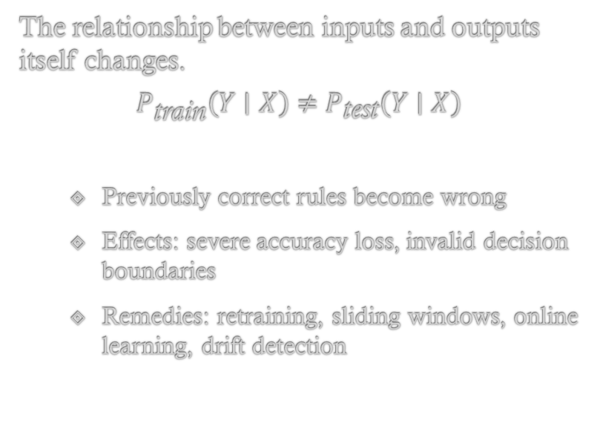
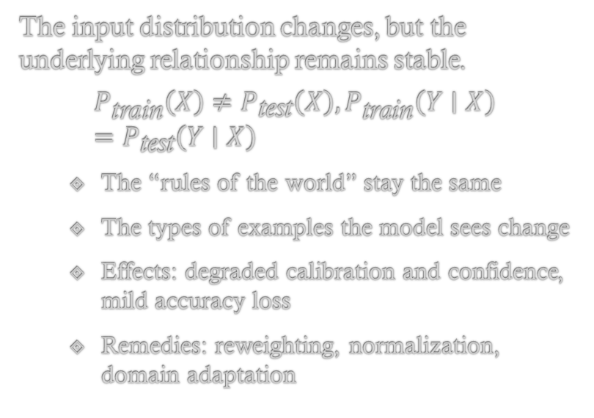
Drift Mechanisms
Covariate Shift
Concept Drift
The input distribution changes, but the underlying relationship remains stable.
$$P_{\text{train}}\left(X\right)≠P_{\text{test}}\left(X\right), P_{\text{train}}\left(Y∣X\right)=P_{\text{test}}\left(Y∣X\right)$$
The “rules of the world” stay the same
The types of examples the model sees change
Effects: degraded calibration and confidence, mild accuracy loss
Remedies: reweighting, normalization, domain adaptation
The relationship between inputs and outputs itself changes.
$$P_{\text{train}}\left(Y∣X\right)≠P_{\text{test}}\left(Y∣X\right)$$
Previously correct rules become wrong
Effects: severe accuracy loss, invalid decision boundaries
Remedies: retraining, sliding windows, online learning, drift detection

Slide 81
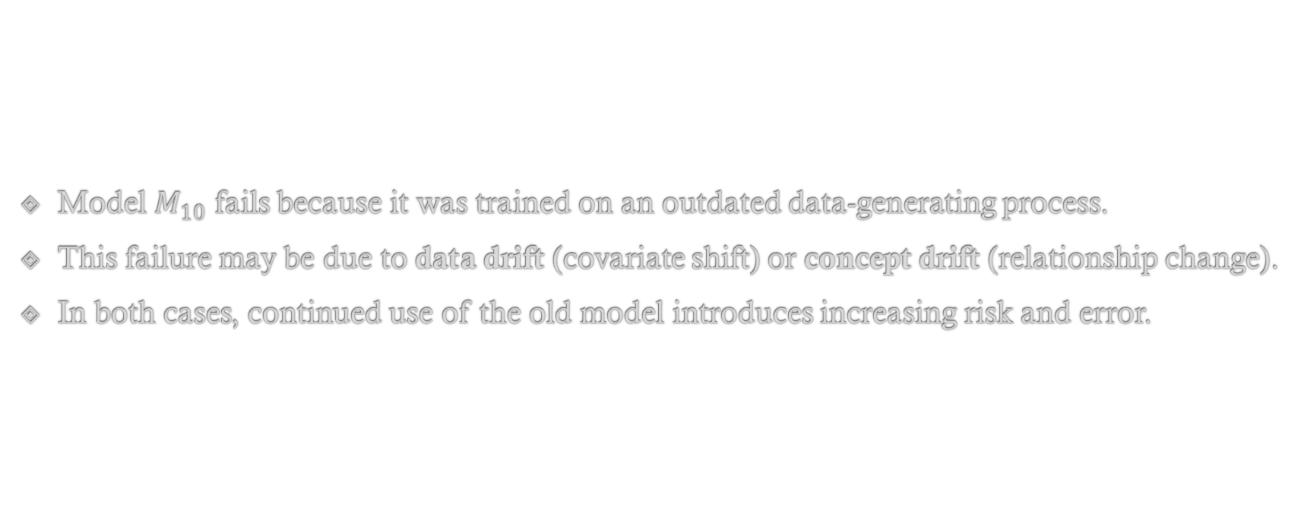
Consequence…
Model $M_{10}$ fails because it was trained on an outdated data-generating process.
This failure may be due to data drift (covariate shift) or concept drift (relationship change).
In both cases, continued use of the old model introduces increasing risk and error.

Slide 82
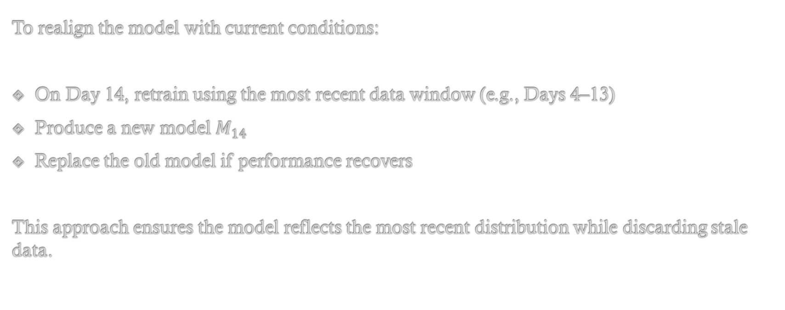
Remedy: Sliding-Window Retraining Strategy
To realign the model with current conditions:
On Day 14, retrain using the most recent data window (e.g., Days 4–13)
Produce a new model $M_{14}$
Replace the old model if performance recovers
This approach ensures the model reflects the most recent distribution while discarding stale data.

Slide 83
Cost vs Benefit
Retraining is done only when feasible, because:
Hence, retraining frequency depends on:
Rate of data drift
Model sensitivity
Cost of retraining
Risk tolerance
Cost | Example
Computational | Large models, GPUs
Data | Label availability delay
Operational | Deployment risk
Financial | Infrastructure cost

Slide 84
Section Summary
Periodic retraining is required for non-stationary data to adapt models to evolving data distributions, thereby preventing performance degradation caused by concept and data drift.

Slide 85
A|B Testing
What is A|B Testing?
Why does it exists?
Confidence Intervals in A|B Testing
A|A|B Testing?
Why does it exist?

Slide 86
What is A|B Testing?
A/B testing is a randomized controlled experiment used to compare two systems— A (control) and B (treatment)—by measuring their effect on a predefined metric under identical conditions.
Randomization ensures that any observed difference is attributable to the system change rather than external confounders.
A classical analogy is medical trials: an existing treatment is compared against a new one by randomly assigning patients and measuring outcomes.
The same logic applies to machine learning systems.

Slide 87
A|B Testing in ML
In machine learning, A/B testing is commonly used to evaluate changes such as recommendation models, ranking algorithms, or ad placement systems.
Model A: current production model
Model B: new candidate model
Metric: Click-Through Rate (CTR)
To manage risk, deployment typically starts with a small traffic allocation to B (e.g., 9:1 split) and gradually increases exposure if results are promising.
This staged exposure is known as progressive rollout.

Slide 88
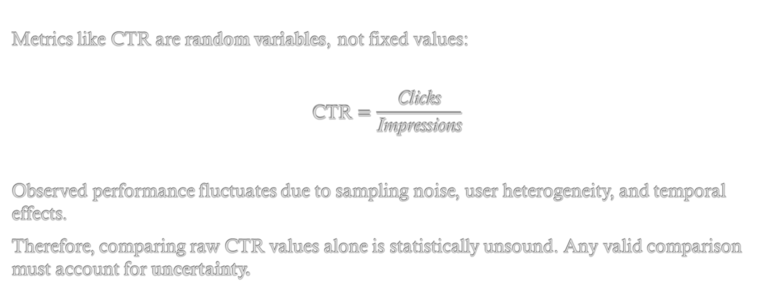
Why Point Estimates Are Insufficient
Metrics like CTR are random variables, not fixed values:
$$\text{CTR}=\frac{\text{Clicks}}{\text{Impressions}}$$
Observed performance fluctuates due to sampling noise, user heterogeneity, and temporal effects.
Therefore, comparing raw CTR values alone is statistically unsound. Any valid comparison must account for uncertainty.

Slide 89
Confidence Intervals and Statistical Interpretation
Confidence intervals (CIs) quantify uncertainty around metric estimates.
A large sample produces a narrow CI (high confidence)
A small sample produces a wide CI (low confidence)
Overlapping confidence intervals indicate insufficient evidence to declare superiority, not that the models are equivalent.
Importantly, CI overlap is only a heuristic—formal decisions require hypothesis testing (e.g., z-test, Wald test, likelihood ratio test).
The key implication is operational: if uncertainty is high, more data is required before replacing a production model.

Slide 90
Why A/A/B Testing Exists
A/A/B testing extends A/B testing by introducing two identical control groups before evaluating the treatment.
Its purpose is to:
Estimate the natural variance (noise floor)
Detect experimental issues (logging bugs, randomization failures, sampling bias)
Prevent false positives
If the two identical controls differ significantly, the experiment itself is unreliable, and any conclusions about the treatment are invalid.

Slide 91
A|A|B Testing Example
Group | Model | CTR
A | Old | 5.0%
A′ | Old | 5.5%
B | New | 5.4%
Without A′: One might falsely conclude B is better than A.
With A′: Difference is within natural variance.
Improvement is not statistically meaningful.
Key Insight:
If A and A′ differ significantly, the experiment is unreliable. A/A testing establishes experimental sanity.

Slide 92
Practical Decision Workflow
Run A/A test → validate experiment
Run A/B test → compare treatment
Use:
Confidence intervals
Hypothesis testing
Minimum detectable effect (MDE)
Roll out gradually if statistically significant

Slide 93
Section Summary
Aspect | A/B Testing | A/A/B Testing
Purpose | Compare old vs new | Validate experiment
Controls | 1 | 2
Detects noise | ❌ | ✔
Prevents false positives | ❌ | ✔
Production readiness | ✔ | ✔✔
A/B Testing:
A randomized controlled experiment used to compare two systems by measuring statistically significant differences in a predefined metric.
A/A/B Testing:
An extension of A/B testing that adds an extra control group to estimate variance and validate experimental reliability.

Slide 94
DS/ML Project Life-Cycle
A look from a higher perspective.

Slide 95
(1) Understand Requirements — Problem Definition
Purpose:
Translate a vague business question into a well-posed analytical or predictive problem.
Key activities:
Identify the end user (customer, operations team, leadership)
Define:
Objective (e.g., increase CTR, reduce churn)
Constraints (latency, cost, interpretability, regulation)
Success metrics (business + statistical)
Critical insight:
A technically excellent model solving the wrong problem has zero value.
Analogy: Like defining what disease to treat before choosing a medical test or drug.

Slide 96
(2) Data Acquisition — Data Engineering Phase
Purpose: Ensure the right data exists, is accessible, and is trustworthy.
Sources:
Databases (SQL: DB, DW)
Logs (application, clickstream)
Distributed systems (Hadoop, Spark)
External APIs or third-party data
Key activities:
ETL pipelines (Extract → Transform → Load)
Data validation and schema checks
Handling missing, delayed, or biased data
Time reality: This phase often takes months and dominates project timelines.
Why this matters: Model quality is upper-bounded by data quality.

Slide 97
(3) Data Preparation — Pre-processing
Purpose:
Convert raw data into model-ready features.
Typical tasks:
Cleaning (missing values, outliers)
Encoding (categorical → numerical)
Normalization / scaling
Feature construction
Key distinction:
Data acquisition = getting data
Data preparation = making data usable

Slide 98
(4) Data Analysis — Exploration & Statistical Reasoning
Purpose:
Understand the data before modeling to avoid spurious learning.
Activities:
Exploratory Data Analysis (EDA)
Visualization (distributions, correlations)
Hypothesis testing
Sampling strategies
Estimated time: Often months, especially for large or messy datasets.
Why this is non-optional:
Models do not discover truth; they exploit statistical regularities—real or accidental.

Slide 99
(5) Modeling, Evaluation, and Interpretation
Purpose: Build models consistent with data properties and business goals.
Key points:
Model choice depends on:
Data size
Noise
Feature quality
Interpretability requirements
Evaluation must use:
Proper validation strategy
Relevant metrics (not just accuracy)
Important dependency: Modeling is constrained by what data acquisition and analysis reveal.

Slide 100
(6) Communicate Results — Decision Enablement
Purpose: Translate technical findings into actionable insight.
Characteristics:
Clear, concise (1–6 pages)
Minimal jargon
Emphasis on:
Impact
Risk
Assumptions
Limitations
Audience: Stakeholders who may not know AI/ML.
Core rule: If stakeholders cannot understand it, they cannot approve or deploy it.

Slide 101
(7) Deployment — Engineering Integration
Purpose:
Turn a model into a reliable production system.
Tasks:
Model serving
Latency optimization
Monitoring hooks
Integration with existing systems
Key distinction: A trained model ≠ a production system.

Slide 102
(8) Real-World Testing — A/B Testing
Purpose:
Measure causal business impact, not offline metrics.
Why this is critical:
Offline metrics often fail to reflect real-world behaviour
A/B testing isolates the model’s effect
Core question:
Does this model add measurable business value?

Slide 103
(9) Customer / Business Buy-In
Purpose:
Secure organizational acceptance.
Includes:
Trust in results
Risk assessment
Cost–benefit justification
Alignment with business strategy
Reality check:
Many technically sound ML projects fail here—not earlier.

Slide 104
(10) Operations — MLOps & Maintenance
Purpose:
Ensure long-term reliability.
Key elements:
Retraining strategy
Failure detection
Drift monitoring
Rollback mechanisms
Explicit requirement:
Define when, why, and how retraining occurs.

Slide 105
(11) Optimization — Continuous Improvement
Purpose:
Incrementally improve performance and efficiency.
Levers:
Better features
More data
Improved models
Code and infrastructure optimization
Key insight:
Optimization is not a phase—it is a loop.

Slide 106
Section Summary
The DS/ML project life-cycle is an iterative process that begins with problem definition and data acquisition, proceeds through analysis, modeling, deployment, and real-world validation, and continues with operational maintenance and optimization to ensure sustained business value.

Slide 107
VC Dimensions (Vapnik–Chervonenkis Dimension)
What does VC Dimension measure?
The Nature of VC Dimension
VC Dimensions applied to Models
VC Dimension vs Practice

Slide 108
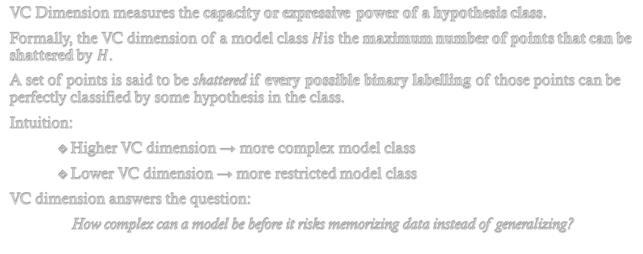
What VC Dimension Measures
VC Dimension measures the capacity or expressive power of a hypothesis class.
Formally, the VC dimension of a model class $H$is the maximum number of points that can be shattered by $H$.
A set of points is said to be shattered if every possible binary labelling of those points can be perfectly classified by some hypothesis in the class.
Intuition:
Higher VC dimension → more complex model class
Lower VC dimension → more restricted model class
VC dimension answers the question:
How complex can a model be before it risks memorizing data instead of generalizing?

Slide 109
The Nature of VC Dimension
VC dimension is a concept from Statistical Learning Theory and is fundamentally theoretical in nature.
Key characteristics:
It is a worst-case measure of model capacity
It is distribution-free (independent of the data distribution)
It applies to a class of models, not a single trained model
VC dimension is mainly used for:
Deriving generalization bounds
Understanding overfitting
Analysing sample complexity (how much data is needed to learn reliably)
From an applied perspective, VC dimension is rarely computed exactly and serves more as an explanatory tool than a tuning parameter.

Slide 110
VC Dimensions Applied to Models
1. Linear Models
Linear classifiers use linear decision boundaries:
Line in 2D
Plane in 3D
Hyperplane in higher dimensions
Examples:
Logistic Regression
Linear SVM
Perceptron

Slide 111
VC Dimensions Applied to Models(cont.)
Linear Models:
Key result:
In 2D, linear models have VC dimension = 3
They can shatter any configuration of up to 3 points
There exists at least one configuration of 4 points (e.g., XOR-like) that cannot be shattered
This shows that linear models have limited but well-defined capacity.

Slide 112
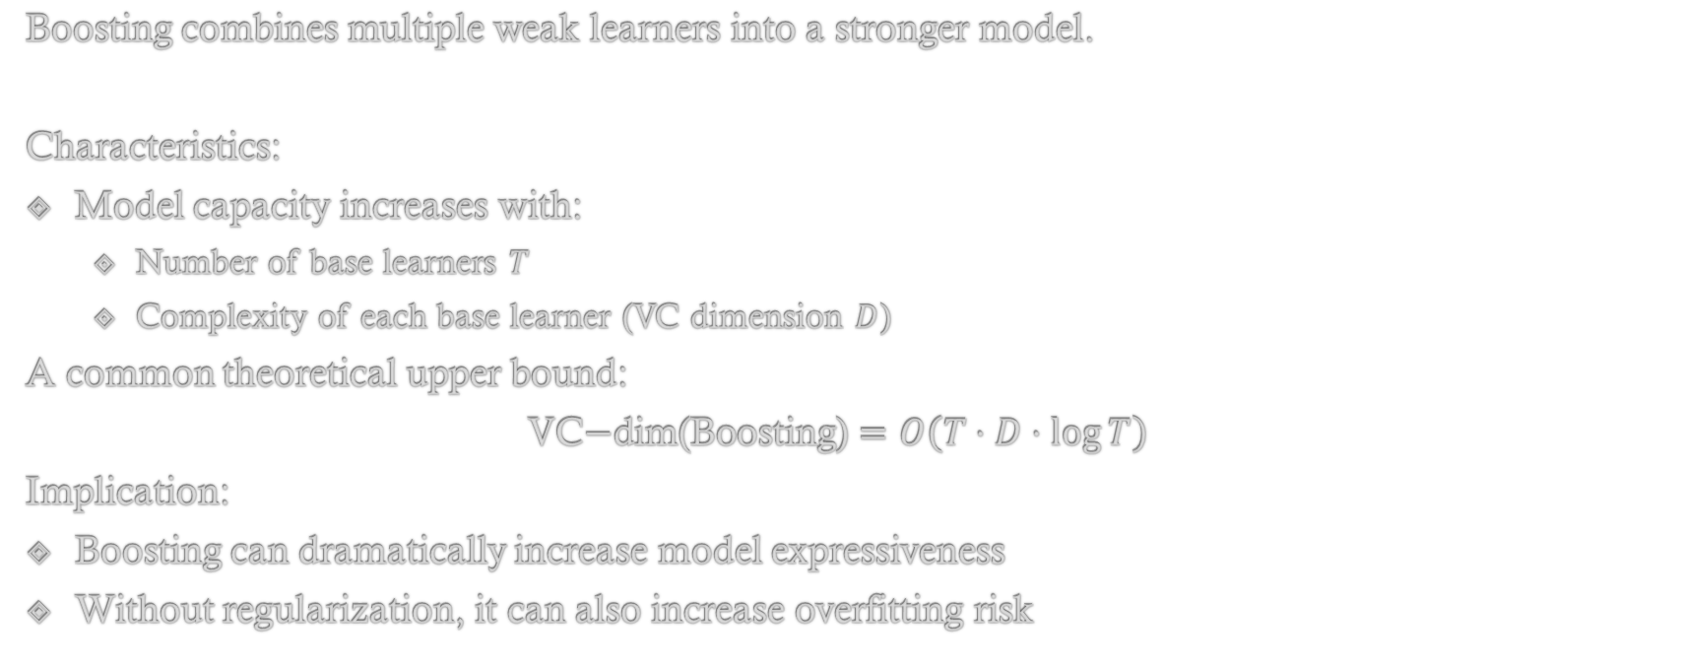
2. Ensemble Methods (Boosting)
Boosting combines multiple weak learners into a stronger model.
Characteristics:
Model capacity increases with:
Number of base learners $T$
Complexity of each base learner (VC dimension $D$)
A common theoretical upper bound:
$$\text{VC}\text{−}\text{dim}\text{(}\text{Boosting}\text{)}=O\left(T⋅D⋅\log{T}\right)$$
Implication:
Boosting can dramatically increase model expressiveness
Without regularization, it can also increase overfitting risk

Slide 113
3. Kernel-Based Models (RBF-SVM)
RBF-kernel SVMs map data into an infinite-dimensional feature space.
Key properties:
Theoretical VC dimension is infinite
Can shatter arbitrarily large finite datasets
Decision boundaries can be highly nonlinear
Important clarification:
Infinite VC dimension does not imply poor generalization in practice
Regularization and margin maximization control effective complexity

Slide 114
VC Dimension vs Practice
In real-world machine learning, VC dimension has limited direct applicability.
Practical performance depends more on:
Regularization strength
Margin size
Noise in data
Feature quality
Data distribution

Slide 115
VC Dimension vs Practice
Key insight:
High VC dimension increases the risk of overfitting
Generalization improves when VC dimension is small relative to dataset size
Thus:
VC dimension explains why overfitting occurs
It does not tell you which model to deploy

Slide 116
Section Summary
VC dimension measures model capacity.
It provides generalization guarantees.
Extremely useful in learning theory.
Largely impractical for applied ML.
High VC dimension ≠ better real-world performance.

Slide 117
Thank You
- Ainesh Avinash Godse, 24XV1M0515

